Slide 1
St Ailbe’s 1st year Information Evening for Parents
Welcome all parents/guardians of all 1st year students
Thank you for selecting St Ailbe’s for your son/daughter.
Notes:
I would like to welcome everyone to our meeting and to thank you picking St Ailbe’s as your school of choice.
I will start by asking my colleagues by introducing themselves and their role.
Noreen & Alannah
I’m Denis Keating the Home School Liaison Teacher, I act as a link between parents, home and school. My role is to support parents as much as possible while their child is in St Ailbe’s.

Slide 2
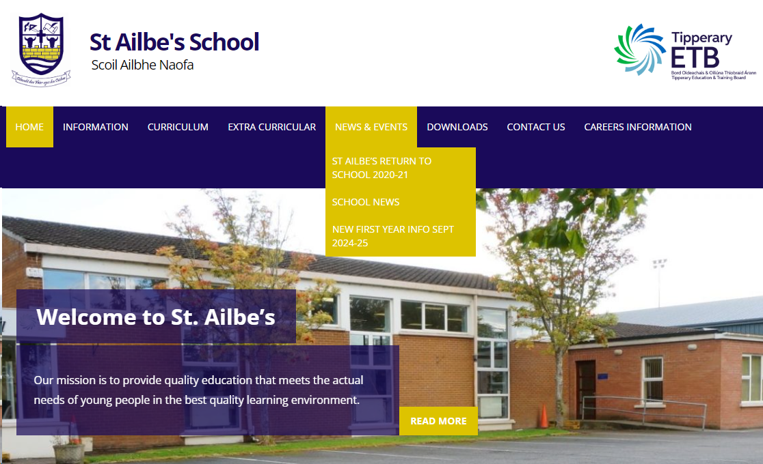
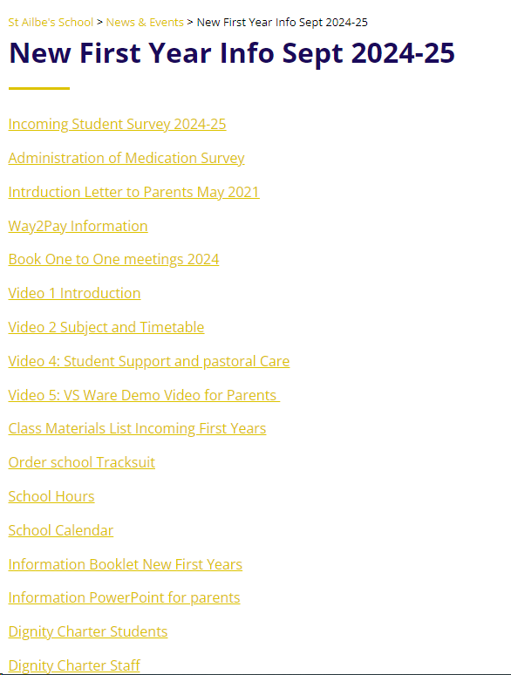
www.stailbes.ie

Slide 3
Outline
Curriculum
Timetables
Materials / Uniform
Pastoral Care/Guidance
VSware
Way2pay
Communication with school / Parents
Student Journal
Notes:
Here is a list of what we will be covering – hopefully we will have you out of here within an hour.

Slide 4
Junior Cycle Subjects
Core subjects:
Irish
English
Maths
Science
History
Career Guidance**
CSPE**
SPHE**
Identity, Multi-belief and Values Education**
**Non Exam Subjects
Option subjects: (Pick 3)
French
Applied Technology
Geography Block 1
Wood Technology
Visual Art
Visual Art
Music
Home Economics
Wood Technology Block 2 & 3
Graphics
Engineering
Business
Geography
Notes:
Lets look at the subjects your child will studying for the next 3 years. Students are examined in 5 core subjects and 3 option subjects at Junior Cycle.
Subjects are divided into 2 categories, Core subjects – on the left and Option on the right.
Every student will study all the core subjects for their 3 years at Junior cycle

Slide 5
Option Blocks (Open to change)
Block 1: French, Geography, Technology, Wood Tech, Art
Students will pick a subject from Block 1 before starting 1st year, either through an on-line survey or based on discussions at the one-to-one meetings with Mr Devitt or Mr O’Dwyer. The reason for this is that we don’t want to wait 15 weeks before starting French.
Block 2 and 3: Business, Engineering, Home Economics, Visual Art, Woodwork, Graphics, Music, Geography
Notes:
Option Subjects are divided into 3 blocks.

Slide 6
Contd.....
Every 3 weeks, for a total of 15 weeks, students will experience 2 new subjects from option Blocks 2 & 3
Throughout the 15 weeks students will take part in a Wellbeing Module
Timetabled subjects will change 5 times from September to Christmas
Each student will carry 8 subjects through to 3rd year.
(5 core and 3 options)
Notes:
Don’t worry every student will experience all the options subjects during the 3 week taster blocks. At the end of the 15 weeks students will have to pick 1 subject from each of block 2 and 3.
Block 1 is different – in that the students in conjunction with yourselves will have to pick 1 subject from the block 1 before starting in September. You can do this on the survey Mr Devitt has sent out or you can wait to discuss your choice during the one-to-one meeting you will be having with Mr Devitt or Mr O’Dwyer at the end of the month, or you might like to discuss it with Noreen.

Slide 7
Junior Cycle Profile of Achievement (JCPA)
At the end of the 3-year cycle students will receive a Junior Cycle Profile of Achievement which will comprise of
2 Classroom-based Assessments (CBA), generally, one in 2nd year and one in 3rd year
Assessment Task (10%), based on the CBA’s
A final assessment (90%) in 3rd year
Notes:
So what happens at the end of the 3 years. Students will receive a Junior Cycle Profile of Achievement based on 2 CBA’s, an Assessment Task and a final examination in 3rd year.

Slide 8
School Day
*Monday & Wednesday Tuesday, Thursday & Friday
4 periods x 40 minutes
starting at 8.50
Break 11.30 – 11.45 (15 mins)
2 periods x 40 minutes
starting at 11:45
Lunch 1.05 – 1.45 (40 mins)
3 periods x 40 minutes
until 3.45
4 periods x 40 minutes
starting at 8.50
Break 11.30 – 11.55 (25 mins)
2 periods x 40 minutes
starting at 11:55
Lunch 1.15 – 1.55 (40 mins)
2 periods x 40 minutes until 3.15
*Long day – short break – early lunch
Notes:
The School Day
Monday & Wednesday are our long days, we finish at 3:45, with a 15 minute break in the morning and 40 minutes for lunch.
Tuesday, Thursday and Friday short days finishing at 3:15, with a 20 minute break and 40 minute lunch.

Slide 9
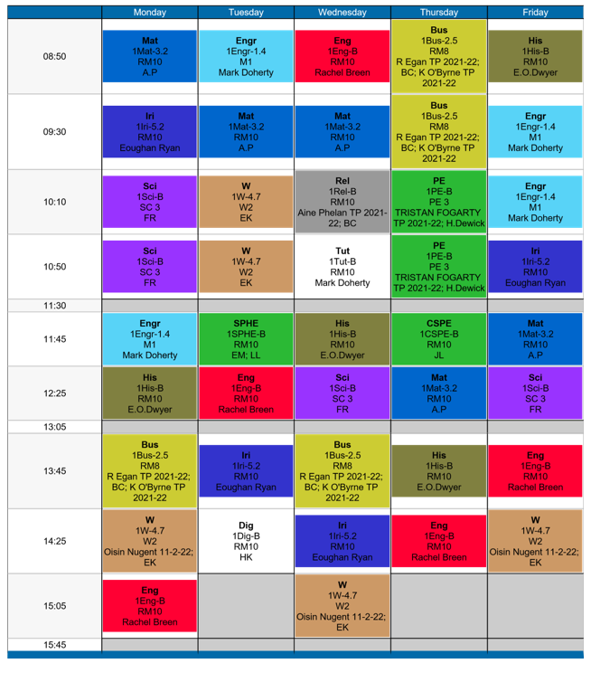
Timetable 1
Notes:
Handout 3 page 6 and 7
Reading the timetable can be confusing so I think it is important to explain it.
It is coloured coded for each subject.
Each block has the Subject on 1st line, French, the next line you can ignore.
3rd line is the name of the class room where it is being taught and the last line is the name of the teacher delivering the subject.
A good idea is to print out 3 copies of the timetable, 1 for at home on the fridge, one for their journal and the last for the inside of their locker. When you log onto Vsware you will be able to see the students timetable as well.

Slide 10
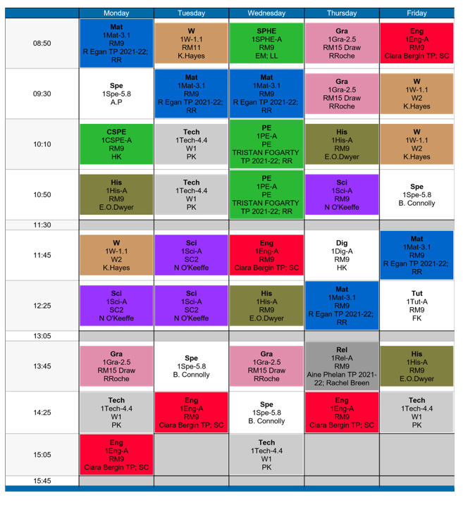
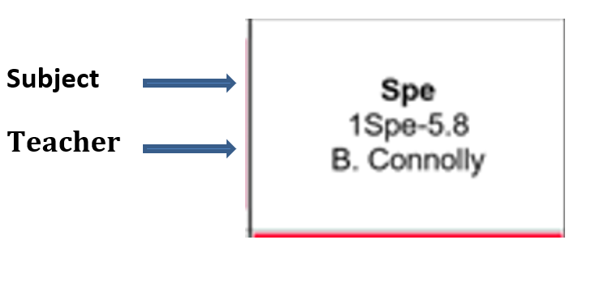
Timetable 2 – SEN Classes
Notes:
The only difference between this timetable and the previous one is this timetable contain`s an SEN class, they will always be coloured white

Slide 11
Class Materials
General Items for Every Subject
Pens at least 3 colours, Sharpener, Eraser,
2B & 6B Pencil, Ruler, Highlighters, Coloured Markers Colouring Pencils, Packet of poly-pockets
Notes:
The list of class material is also available on the website, please try to ensure that your child has all the necessary materials before school starts as it will make life easier for them.
Handout 1 page 4 of Parent Information Booklet

Slide 12
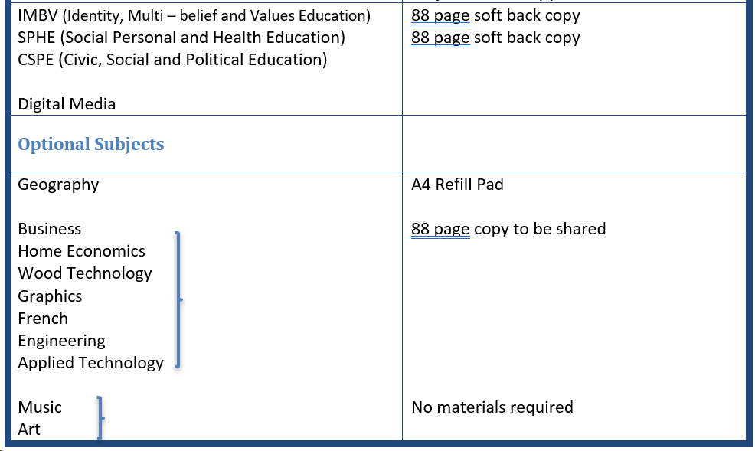
Notes:
Handout 1 page 4 of Parent Information Booklet

Slide 13
Schoolbooks Scheme
Under the schoolbooks scheme the following is provided free of charge:
All relevant textbooks and workbooks
School Journal
12 copybooks (A mix of hardback, tough shell and softback)
1 Science copybook
1 calculator
1 formulae and tables/log book (2nd/3rd year as needed)
English/Irish Dictionaries (as needed)

Slide 14
Uniform / Boys & Girls
Navy Pants – Pleated Check Skirt is also an option for girls.
Navy V – Neck Jumper (School Crest).
White Shirt with Collar
Black / Dark shoes.
St Ailbe’s Tracksuit (Idsportshop.com) - Fitting date in June, will be notified.
Notes:
Uniform is a navy pants with v neck jumper with school crest.
There is a school track suit which is only available on line from Idsportshop.com
There will be a fitting arranged in school for 26th June with a second one in late August, try to attend the June fitting as it takes 6-8 weeks to receive your order. We will let you know the exact dates nearer to the time.

Slide 15
Extra Curricular Activities
Basketball
Rugby
Football
Hurling
Coding
Camogie
Dungeons & Dragons
Athletics
Golf
Choir
Soccer
Spike Ball
School Musical
Games Clubs
Music Generation
Debating
Create new clubs
Ultimate Frisbee
Horse Riding

Slide 16
Pastoral Care & Guidance Teams
Notes:
I will now pass over to Edel and Alannah who will talk about pastoral care and guidance.

Slide 17
Supports to Assist 1st Years
Stay Safe
Friends For Life
Transition Program
Mentor/Buddy
Alert Program
Homework Club
Evening study
Counselling Services
Numeracy Ninjas
Don’t be mean behind the screen
Working Things Out
Check & Connects

Slide 18
Homework Club
No Charge
1hour after school
Monday & Wednesday
4:00 – 5:00
Tuesday & Thursday
3:30 – 4:30
Fully Supervised
Food/snack provided
Register is maintained and absenteeism monitored on VSWare

Slide 19
Evening Study
No Charge for 1st years
1-2 hour after school
Monday & Wednesday
4:00 – 5:00 / 5:50
Tuesday & Thursday
3:30 – 4:30 / 5:30
Food available before starting
Fully Supervised
Register is maintained and absenteeism monitored through VSWare

Slide 20
Guidance Counsellors – Noreen and Edel
Our role is to assist students through learning experiences to develop self-management skills which will lead to effective choices and decisions about their lives. It encompasses the areas of personal and social development, educational guidance and career guidance
1st year 2 modules with a Guidance Counsellor
Module 1-Moving to Second Level, programme over 6 weeks which helps students to become more familiar with their new school and feel a connection to it, where to go for help if they need it and to identify stressors (if there are any) in making the transition to second level

Slide 21
Module 2 – Restorative Practice
Restorative practices help us develop and sustain strong and happy school communities by:
Actively developing good relationships
Preventing the escalation of conflict
And handling conflict in a creative a healthy manner
1st Year Module we help students use restorative language to:
Express their feelings and needs to promote connection and build relationships
We use restorative circles and conversations
To help students handle conflict in a healthy manner and we try and help them create a community of care and take responsibility for their own wellbeing

Slide 22
SCHOOL AND EDUCATION
RELATIONSHIPS AND FRIENDSHIPS
CHILDHOOD TO ADOLESCENCE

Slide 23
SCHOOL AND EDUCATION
School building - moving and base room
Lockers
9 different teachers in one day
Teaching styles and personalities
Subjects/timetable
New timetable
Canteen
School Diary
Homework management. Some homework may not be due in for a few days.
Examrevision.ie

Slide 24
Examrevision.ie

Slide 26
The School
Canteen – Fob Costs etc.
Lockers – Timetable with blue-tack or in poly pocket Zip Lock – colour coded
Uniform – names on everything
First Day: Nerves Bus, Bag, Pencil case, in uniform, supply of copies
School Office – Clodagh and Mary
Caretakers: Nicky, Bob, Mary.

Slide 27
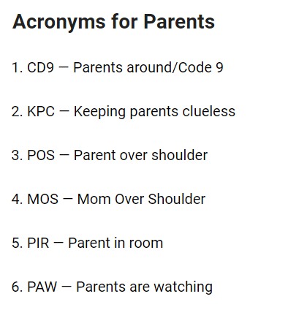
TIME TO UP-SKILL

Slide 28
RELATIONSHIPS & FRIENDSHIPS
From Senior Students to Junior Students
Be kind to everyone
Friendship groups change
Get to know students from other schools, new and old friends.
HERE TO LEARN, TO HAVE FUN

Slide 29
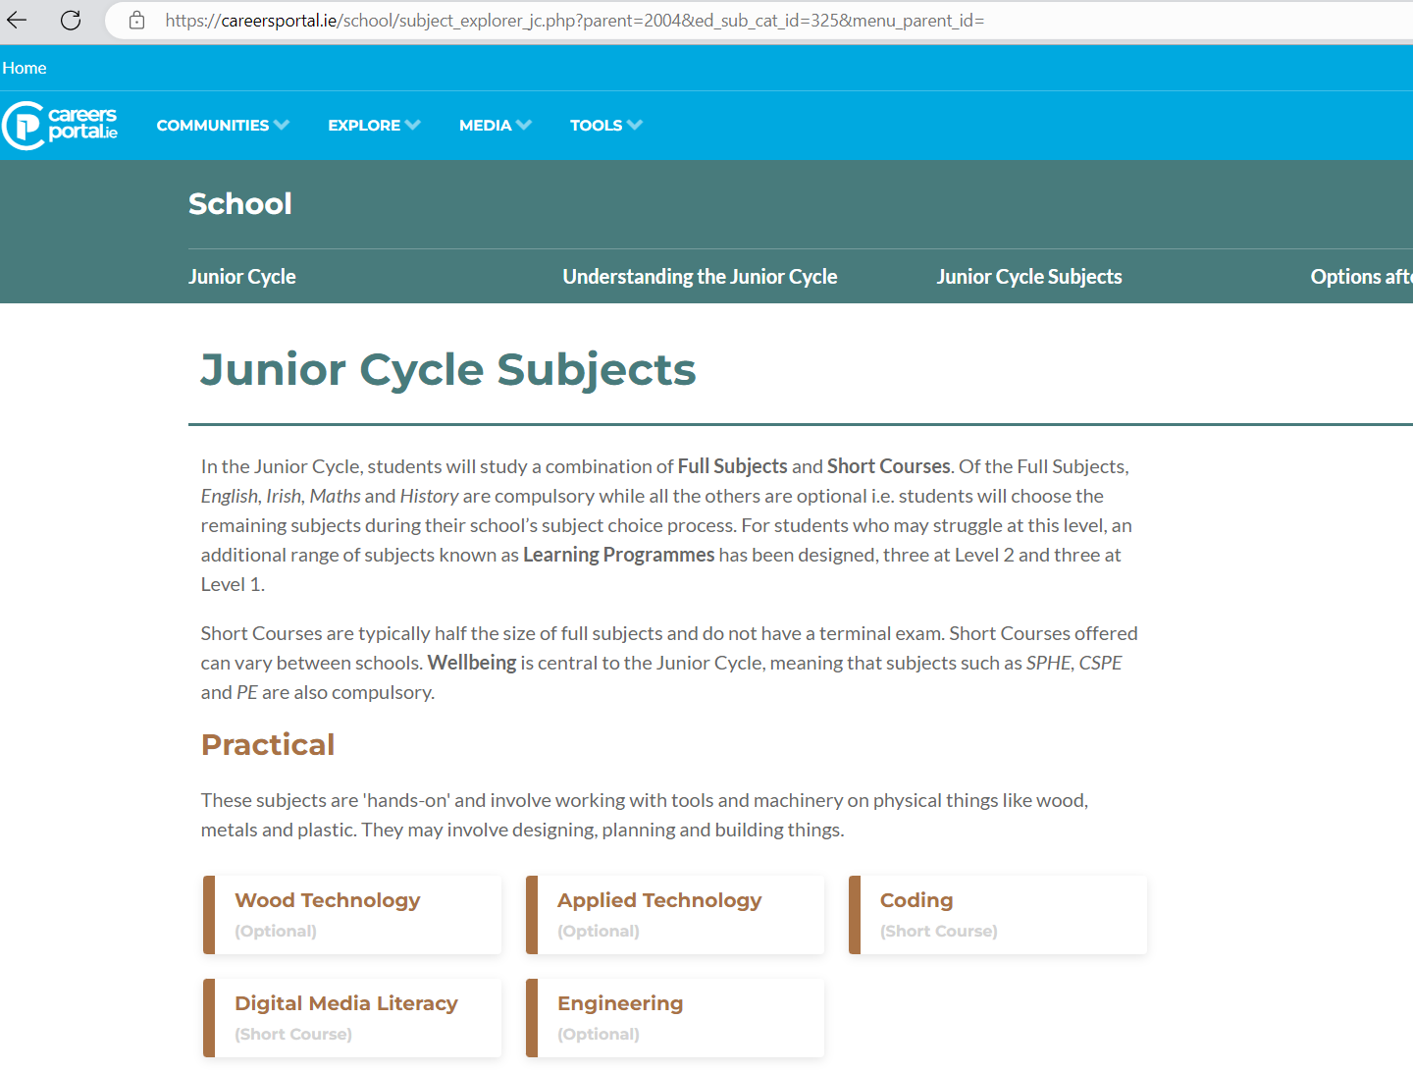
Contd....
Vocational
Adolescence is a time for searching for and identifying
possible careers www.careersportal.ie

Slide 30
THINGS TO CONSIDER
We all have our own unique set of strengths
With adolescence comes ownership and responsibility
Self esteem is often fragile at this time. Relationships/friendships play a major role.
Helpful Boundaries, Be the reason to say no
Active participation in growing up – school, friendships, sport, extra-curricular activities
Do encourage a good night’s sleep. sleep and rest are important

Slide 31
SOMETHING TO THINK ABOUT!
“What I need most is to feel loved and valued, no matter how foolish I may seem. I need someone who believes in me because I do not always believe in myself.......”
By Virginia Satir

Slide 32
VSware
VSware is a management tool used for recording Assessment, Attendance, Behaviour, Timetabling and sending Text Messages. You can download the app from the App store or go through the St Ailbe’s website. Instructions available on the website under Downloads.
Parents/Guardians have access to VSware where they can see their son/daughters Personal Details, Attendance, Behaviour, Timetable and all Term Reports. It can also be used for parents to enter reasons for absence, appointments, signing out etc.
You will receive a Username and Password by Text to access VSware
Notes:
To help you follow your child's progress during the year all parents/guardian have access to VsWare, here you will see information on attendance, behaviour, time tabling. We also use it to send notifications and text messages.
You can download the app from the App Store or log in through the St Ailbe’s website.
Details of your log on will be send by text.

Slide 33
Term Reports can only be seen on VSware, they are no longer posted home.
Check VSware on a daily/weekly basis for to help keep you informed on attendance, behaviour, etc.
Please use the office phone if you're trying to contact you child during class time.
Notes:
Just be aware we are no longer posting out term reports of examination results, they will only be available on VsWare, you will be informed by text when the window for viewing the reports opens.

Slide 34
Way2Pay
Online payment system for School Fee and Extra Curricular Activities, which can be accessed on St Ailbe’s website
Debit card is required for payment
Valid mobile number as on enrolment form
Text message with link/password late June/July
Receipts issued by text
Cash only payment at office
Cheques payable to Tipperary ETB only
Notes:
We would encourage you to use the Way2Pay system for paying the school contribution or any other payment that is required during the year.
You do need a Debit card to use the system and a valid mobile number.
Like VsWare you will be sent a text message with the link and password.
Way2Pay can be accessed on the website.

Slide 35
School Fee
The school fee for first year is €100 for the year which will be due in mid-August. The school fee covers the cost of:
1) School insurance
2) Locker and locker key
3) Classroom Materials for practical subject taster blocks 4) Photocopying
5) Student testing (PPAD-E test for literacy and numeracy test)
6) Bus costs
7) Examrevision.ie

Slide 36
The following is provided to all first-year students for free:
1) All school text books
2) School journal
3) Copies and hardshell copies
4) Subject colour coded folders
4) Access to examrevision.ie
5) Numerous school educational activities
Please note this will be subject to change

Slide 37
Student Journal
Code of Behaviour
Code of Discipline/ Ladder of Referral
Permission to Leave School
Message to Parents
Report cards
Positive Behaviour Tracker
White Report
Yellow & Red Report
Notes:
The student journal is a very important book, it contains a great deal of useful information. All teachers use it to communicate with home so keep an eye on any entries that are made. Make sure to sign it every week as the assigned class teacher will be checking them weekly.

Slide 38
Dates for your diary:
Wednesday 26th June – tracksuit fitting. There will be an online booking system.
Thursday 22nd August – 1st year registration. Students can collect their books, tracksuit, locker key and journal.
Tuesday 27th August – first day of school. First years only.

Slide 39
Contact Details
Noreen Ryan – Guidance and Counselling
noreen@ailbes.com Ext. 104
Edel Merrign - Guidance & Counselling
edel@ailbes.com Ext: 104
Alannah O’Donovan - School Completion alanna@ailbes.com Ext: 111
Denis Keating – HSCL
denis@ailbes.com Ext: 103
Notes:
Here are our contact details.
We will email the presentation in case you missed anything.

Slide 40
Thank you for attending our Transition Evening – please feel free to ask any questions. Alanna, Edel, Noreen, & Denis

