Slide 1
Where To From Here?
St. Ailbe’s School
Progression information Night
Welcome – Mr Kieran O Dwyer, Deputy Principal
The Further Education Sector – Including Apprenticeships
Ms Noreen Ryan Guidance Counsellor National Tertiary Office Further and Higher Education
The Higher Education Sector & Accommodation Ms Edel Merrigan Guidance Counsellor
HEAR/DARE/SUSI/Mr Eoin Kennedy HSCL
Many paths lead from the foot of the mountain, but at the peak we all gaze at the single bright moon – Ikkyu
Notes:
Most of what I will cover tonight is in the CAO Handbook and has been covered with the 6th years.
In this format we can’t go through every detail but I’ve picked out the points I feel parents should be aware of.
Less stress / tension if everybody is familiar with the system and we are all singing from the same hymn sheet .

Slide 2
Opportunity Indicators

Slide 3
Skills Required

Slide 4
Skills Shortages

Slide 5
The Pathway Through Education – The Qualifications Framework
CAO Level 6/7
PLC/FE
NTO
LCE/ LCVP
Apprenticeships
CAO Level 8
LCA
Level 5
Level 6
Level 7
Level 8

Slide 6
Further Education and Training Courses
Leaving Cert Applied Students
Students not ready /unsure/too young for university (Level 5 FE/PLC).
Students who want access to university via the Higher Education Links Scheme.
Discover a vocational area- Rule in or Rule out.
Assessment Predominantly Project Based with some exams.

Slide 7
FET courses:
Offer a great variety of courses in your locality, designed for the industry you want to get into. E.g. childcare
They are a qualification in their own right
They can be an alternative route into university or college.

Slide 8
They often act like a “stepping stone” into college or university.

Slide 9
FE graduates often go on to gain higher education & training awards too.

Slide 10
Higher Education Links Scheme
Places can be reserved for Level 5 certificate (NFQ Level 5) holders. Offered in order of merit, based on ranking.
Full Award at level 5 to apply for a level 6/7 on CAO At Least three Distinctions to get Level 8

Slide 11
College of FET Limerick
Guaranteed pathway to TUS Limerick.
No specific module requirements
FE course

Slide 12
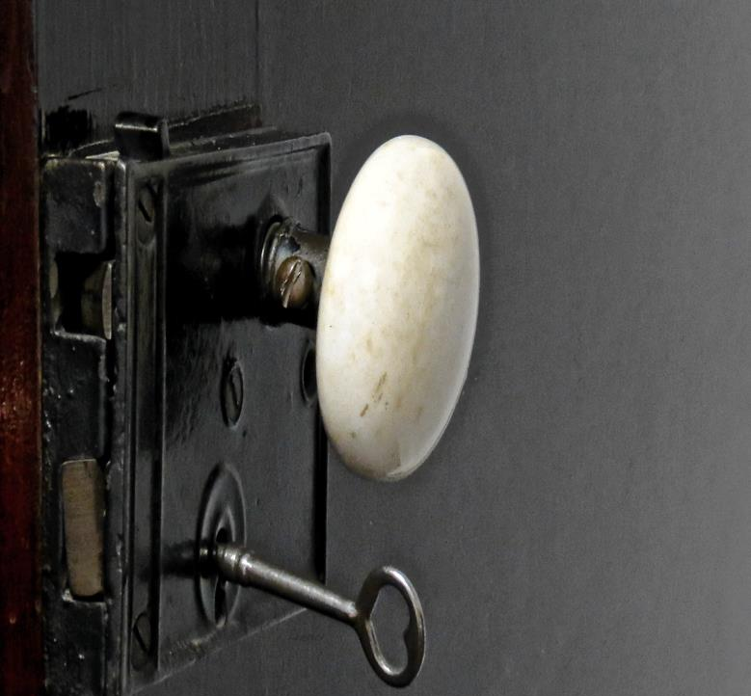
Minimum Entry Requirements To Technological Universities
Always check with the institute of technology admissions office.

Slide 13
Applications
Apply as early as possible to secure a place on fetchcourses.ie
Application is free

Slide 14
SUSI Grants
You can also receive a maintenance grant from SUSI when doing a FET course.
P.86

Slide 15
To sum up

Slide 16
Advantages of A Further Education Course?
Smaller classes than Universities/Colleges.
Students have access to a good support system.
It’s a cheaper option than doing the wrong University course.
There are a wide diversity of course choices.
These courses are only one or two years long with a certificate on completion.
Students gain confidence and maturity while learning
Pathways – Higher Education – HELS Scheme
Local - Tipperary ETB, The Community Centre in Tipperary Town, The Mall in Clonmel, Scoil Mhuire in Thurles, LCFE Limerick

Slide 17
Currently 40 Courses Available covering Nursing, Business, IT, Arts, Engineering, Manufacturing, Construction. Applications from 1st Feb - to Sept – Through ETBs.
New courses coming on stream all the time.

Slide 18
Benefits
No Points Race - Entry requirements are different for each degree, so check the course page to be sure.
Registered with both campus –This includes libraries, sports facilities, and academic, health and wellbeing supports.
You’ll have a student card for both the ETB and the HEI from day 1 of your degree.
Smaller class sizes
No Fees at FET Level – SUSI available
Dream Degree to Dream Career
All new tertiary degrees are designed around gaps in the Irish job market.

Slide 22
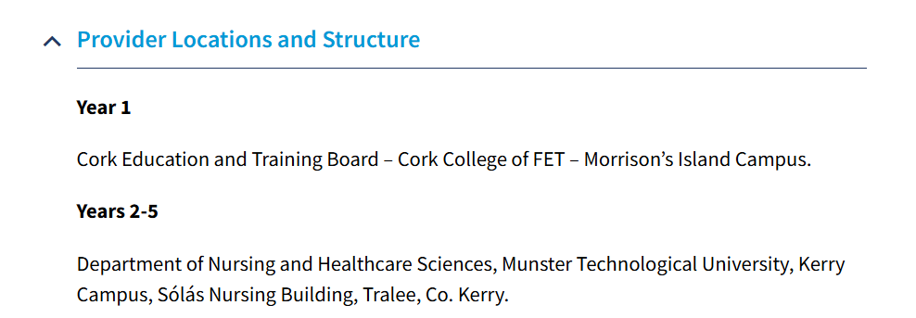

Slide 23
What is an apprenticeship? Level 6
An apprenticeship is a programme of structured education and training which formally combines and alternates learning in the workplace with learning in an education or training centre.
It is a dual system, a blended combination of on-the-job employer-based training and off-the-job training.
Notes:
See previous slide

Slide 24
Key Features of an Apprenticeship
It is industry led
It can lead to levels 5-10 on the NFQ
It is between 2-4 years in duration
There is a minimum of 50% on the job learning
It can be a flexible delivery – online, blended, off the job learning in increments/blocks
The State funds off the job learning
Apprentices are employed under a formal contract of apprenticeship
The apprentice is paid for the duration of the apprenticeship

Slide 25
Types of Apprenticeship

Slide 26
I’m interested, what next?
Research the types of Apprenticeships available – www.apprenticeships.ie
Talk to a person already working in your chosen industry
Talk to your local Apprenticeship Team in your nearest Education and Training Board
Contact industry on apprenticeships – they may be managing recruitment e.g. Johnson & Johnson
Search for apprenticeship opportunities using job search engines and local advertisements
Follow Apprenticeship on Facebook, Instagram, Twitter, Linkedin
There is now a link on the CAO page which will bring you directly to www.apprenticeship.ie

Slide 27
Entry Requirements
Gain employment with an approved employer
Educational and age criteria varies depending on apprenticeship. Check apprenticeship.ie for entry requirements

Slide 28
GOING TO COLLEGE IN 2025

Slide 29
Career Service in St. Ailbe's
Individual Career appointments
Feedback on Cognitive Ability results (CAT – Parent Meeting
Completion of interest inventories (REACH+)
Visiting speakers from colleges
Open Days – UL, TUS, Mary I, SETU
Study Skills
St. Ailbe's Careers Exhibition (5th December 2024)
Classroom based Career classes

Slide 30
Student’s/Parent’s Responsibility
RESEARCH thoroughly all the courses for which he/she is making application. This means find out about the course content/modules for each year of the course. Is work experience part of the course?
All Colleges give a detailed breakdown of the course, go to the website type in the course in the search engine and all the modules studied can be seen
Do not look at 1st Yr. only, look at content for all years of the course.
Be familiar with the procedures for each course e.g. is the course a restricted course? What are the minimum entry requirements for this course? Do I have the necessary subjects?

Slide 31
Useful Resources to Assist with Research
Guidance Counsellors
Subject Teachers
Careers Portal
College Websites
College Faculty (email and phone number beside each course on College website)
CAO (online)
Past Pupils

Slide 32
National Framework of Qualifications (NFQ)

Slide 34
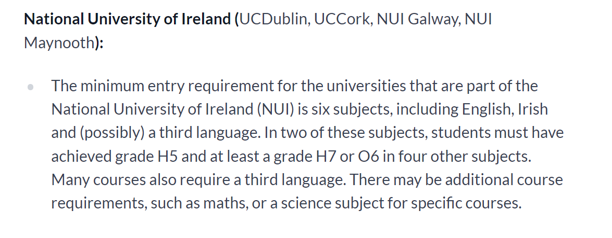

Slide 38
Common Points Scale

Slide 39
LCVP - POINTS
Grade | Points
Distinction | 66
Merit | 46
Pass | 28

Slide 40
Adding up the points (Add the 6 highest scores)
Subject | Level | Grade | Score
Irish | Higher | H2 | 88
English | Ordinary | O2 | 46
Maths | Higher | H5 | 56+25=81
French | Higher | H6 | 46
Biology | Higher | H3 | 77
Geography | Ordinary | O3 | 37
History | Higher | H5 | 56
LCVP | Common | Merit | 46
 |  | Best 6 scores | Points = 394

Slide 41
What is the CAO?
Central Applications Office
based in Galway.
What do they do?
They process all applications to undergraduate courses in Higher Education Institutions (HEIs).
What do they NOT do?
They do not SET the points each year.

Slide 42
CAO Course Choices
There are 2 Course Choice Lists:
Level 6/7and Level 8
10 selections can be made in each list (two forms in one)
It is very important that course choices are placed in genuine order of preference.
Choices are made using a course code:
E.g. Law and Accounting in University of Limerick is LM 020.
Be careful with course codes especially with the new names of the collges, ATU, MTU, TUS etc
Level 8 choices do not affect Level 6/7 choices.
It is possible to receive an offer from both lists.
Only one offer can be accepted in August.
There are usually three rounds of offers.

Slide 43
Making an Application
Students apply online.
Students can only make one application.
Students must apply before 1st of February (thirty euro before 20th Jan, forty five euro after this date).
Restricted courses must be applied for by 1st February.
A new email account could be activated just in case important CAO information goes into spam folder or alternatively you can add an email address to your email provider to avoid this.
Students must then create an application account, log in and enter details.
Keep record of log in details.
Always keep proof of application, print online documentation or obtain a certificate of post.

Slide 44
Restricted Courses
Don’t forget certain courses must be applied for in the first round.
These are courses that need a portfolio or interview as well as points. E.g. Music, Art, etc.
All the information is on the University/Colleges websites.

Slide 45
After Making an Application
Students will receive CAO number by email and use ‘My Application’ to check their application details.
Some students may be called for extra assessments (interviews/musical performance etc) for restricted courses.
Students will receive a statement of application record – check details carefully, make sure you reply to the email if needed.
Change of mind facility becomes available – use carefully especially after exams.
Leaving Cert Results are sent to CAO.
Places are allocated and offered.
Students accept, reject or defer offered places.
Further rounds of offers are made until all the course places have been filled.

Slide 46
Change of Mind
A Change of Mind Form comes with the Statement of Application Record.
Once a student has registered with the CAO they can change their course choices online from the 5th of May 2025
There are no limit to the amount of changes a student wishes to make.
A students final decision has to be made by the 1st July 2025.

Slide 47
Genuine Order
of Preference
You do not need to guess what the points are going to be for the courses you are interested in.
Simply list your courses in genuine order of preference from the highest preference 1, to the lowest preference 10.
If you are entitled to an offer, you will be offered the highest preference that you are entitled to.
Notes:
47
47

Slide 48
CAO Important DATES
5th November | CAO Application Opens
20th January 2025 | Apply online by this date to avail of the discounted application fee of thirty euro
1st February 2025 | Normal closing date for applications (Restricted entry courses)
14th – 23rd February 2025 | HPAT test – Undergraduate Entry to Medicine
1st March 2025 | Final date for completion of online HEAR and DARE application forms
5th May 2025 | Online change of mind facility opens
1st July 2025 | Change of mind facility closes

Slide 49
Allocation of College Places
The same procedure takes place for both lists on the form, therefore in August students may get 2 offers, an offer from Level 8 courses and an offer from Level 6/7 courses. However students may only accept ONE course.
Students must think carefully about not accepting one of these offers as they may not receive any further offers in subsequent rounds.
Regardless of whether or not students accept or reject a course in round 1, they may still be offered a higher preference course in subsequent rounds if they become entitled to one.

Slide 50
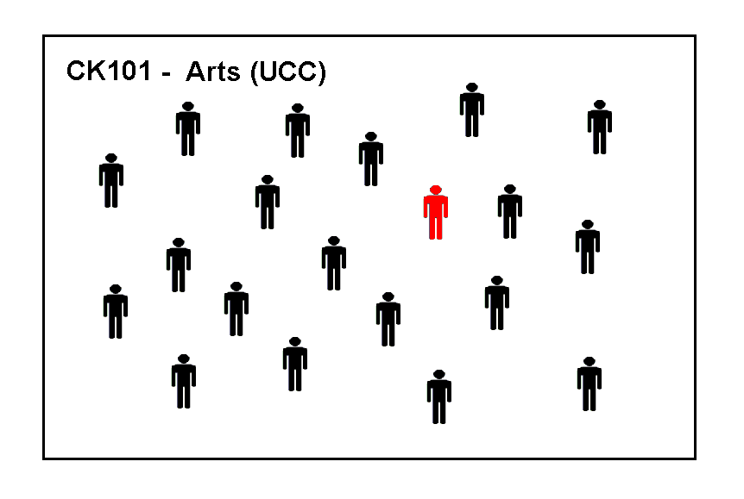
These are the applicants for CK101 (Arts in UCC)
The examination results have not yet been released, so these applicants are in no particular order.
We are going to trace the progress of the applicant marked in red.
Notes:
50
50

Slide 51
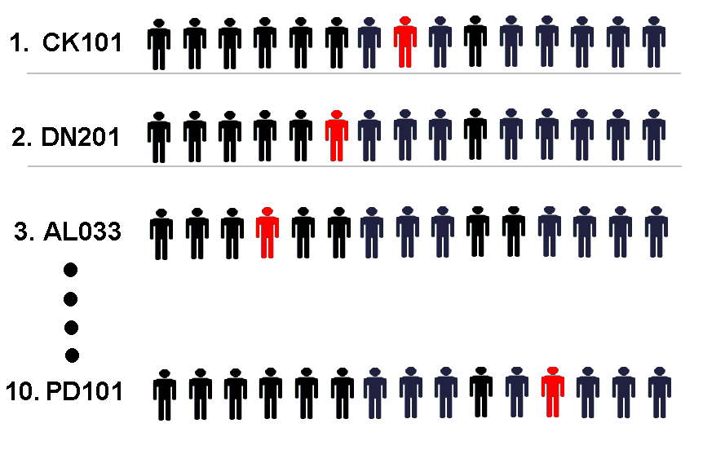
Results are issued. Applicants are placed in a queue for each course they applied for, their position in the queue is determined by their points. The applicant with the highest points is placed at the top of the queue.
The points achieved by the applicant in red determines her position in the queue for each course he applied to.
Notes:
51
51

Slide 52
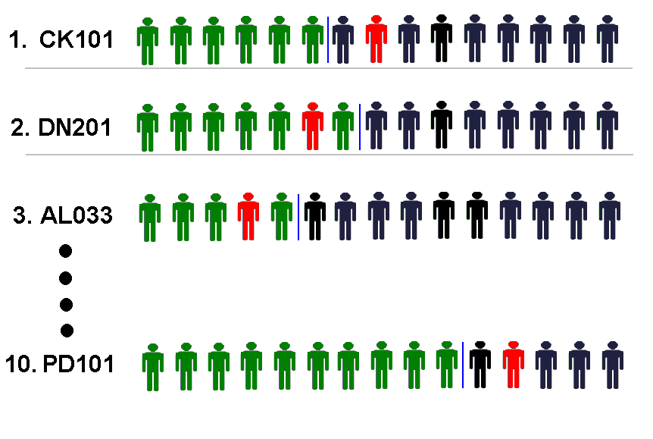
The applicants marked in green have enough points to be offered places.
The applicant marked in red has enough points for his second preference.
Notes:
52
52

Slide 53
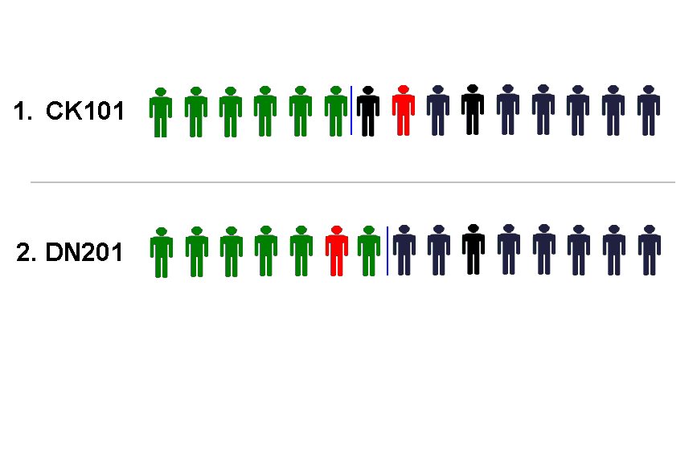
The applicant in red is offered his second preference, the highest preference course that he has enough points for, and he will now disappear from the queue in all his lower choices.
Notes:
53
53

Slide 54
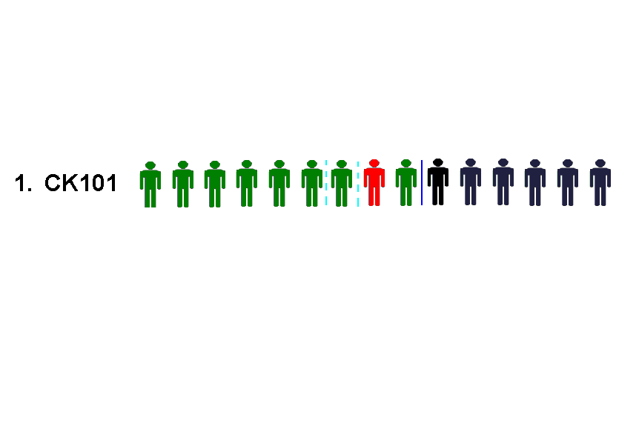
In the Second round of offers three more offers are made on CK101 and our applicant, who was second in line, now receives an offer.
He may do nothing and remain in DN201 or he may accept the offer and begin in CK101.
Notes:
54
54

Slide 55
Important Information
If a student has an exemption from Irish and/or a third language they must complete an NUI Exemption Form to ensure that they meet the entry requirements of UCD, UCC, NUI Maynooth and NUI Galway and other NUI Colleges (Info on College websites)
Visit www.cao.ie for more information on exemptions
SUSI (Student Universal Support Ireland) is Ireland’s national awarding authority for all higher and further education grants
SUSI offers funding for eligible students in approved full-time third –level education in Ireland and also in some cases funding for students studying outside the state.
To see if you are eligible for a SUSI grant visit SUSI.ie and click on eligibility reckoner
If you think that your son/daughter may be eligible for a SUSI grant, when filling out the CAO form make sure to click the box beside SUSI in the grant section

Slide 56
Commonly asked questions
I've received an offer of my 2nd preference, if I accept this offer does this mean I won't get any further offers?
I've received my 3rd preference but would prefer my 4th, what should I do?
I have the points, why didn't I receive an offer?

Slide 57
Accommodation
Early

Slide 58
Summary
Research courses thoroughly.
Apply by January 20th 2025 to avail of thirty euro fee. (late applications after this date are charged a higher fee)
Set up a separate email account/Add email address to current email provider so CAO correspondence does not go into SPAM folder.
Apply online.
Pay by debit/credit card.
Put courses in genuine order of preference.
Obtain/Retain proof of application.
Read all emails from CAO carefully
Be careful with change of mind (especially after LC Exams).

Slide 59
HEAR & DARE APPLICATION 2024/25
www.accesscollege.ie for full details

Slide 61
HEAR
Higher Education Access Route
It is a third level admissions scheme for school leavers who for social, financial or cultural reasons are under-represented in third level education. Eligible students may be offered places on reduced points and receive extra supports in colleges that run the scheme.
DARE
Disability Access Route to Education
It is a third level admissions scheme for school leavers whose disabilities have had a negative impact on their second level education. Eligible students may be offered places on reduced points in the colleges that run the scheme

Slide 62
What does ‘reduced points’ mean?
If you apply to HEAR/DARE and meet the application criteria you may be offered a place even if you do not have enough Leaving Certificate points for your preferred course. CAO points 350, HEAR/DARE 340
You still need to meet the minimum entry requirements and any specific programme requirements before being considered for a HEAR/DARE
Each of the colleges set aside a quota of places for HEAR/DARE students each year.

Slide 63
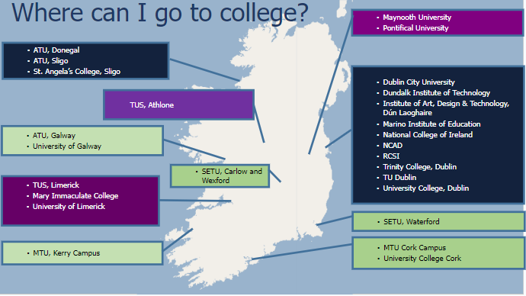
Map showing higher education institutions participating in HEAR and DARE

Slide 64
HEAR Application

Slide 65
How do I know if I’m eligible to apply to HEAR
*Indicator 1 - Low Income (Must have Indicator 1 plus correct combination of 2 other indicators)
Is the household income below the HEAR Income threshold in 2023? €46790 fewer than 4 dependant children
Indicator 2 - Medical Card
Your family has a Medical Card/GP Visit Card in date on 31st December 2024.
Indicator 3 - Social Welfare
Is the applicant’s parent(s) or guardian in receipt of a means-tested social welfare payment for a minimum of 26 weeks in 2023.
Notes:
6 indicators. Page 3 of handout

Slide 66
Indicator 4 - Socio-Economic Grouping (based on occupation and employment status)
Is the applicant a member of a group underrepresented in higher education i.e. non-manual workers, semi and unskilled workers.
*Indicator 5 - DEIS School (Every St Ailbe’s Student)
“DEIS” scheme (Delivering Equality of Opportunity in Schools) for the duration of their second level education.
Indicator 6 - Geographical Area
Does the applicant live in an area of concentrated disadvantage – high unemployment and poverty, or a small proportion of adults attend third level education.
Search for Pobal maps deprivation

Slide 67
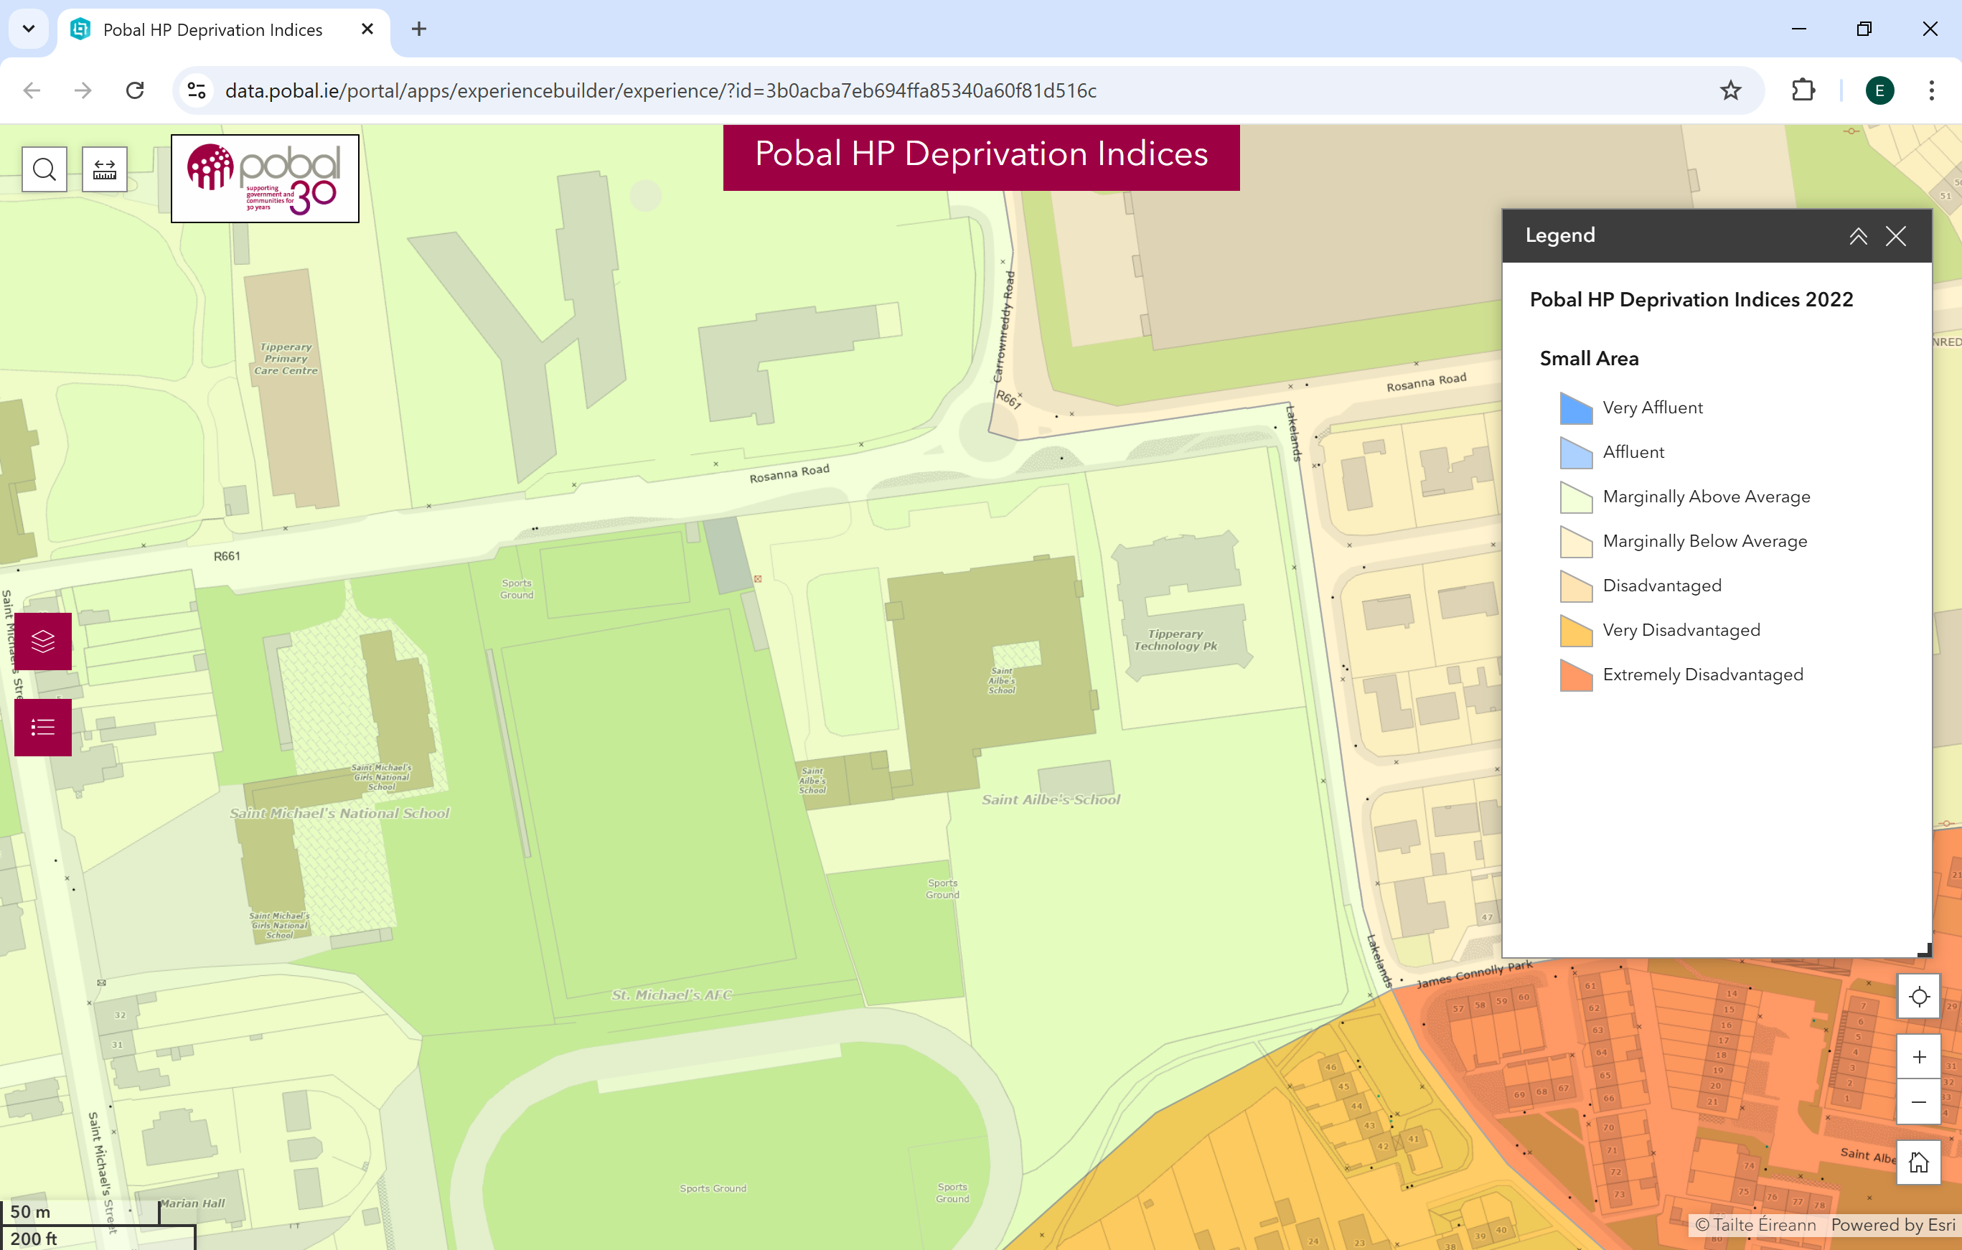

Slide 68
The combinations of Indicators for eligibility are:
1+ 2 +
4 or 5 or 6
1+ 3 +
4 or 5 or 6
1+ 4 +
5 or 6
1+
5 + 6
INDICATORS
1 Income €46790
2 Medical/GP Visit Card
3 Social Welfare Payment (26 wks 2023)
4 Socio-economic Group (non-manual, semi & unskilled manual workers)
5 DEIS School
6 Concentrated Disadvantage

Slide 69
How do I apply?
Apply to CAO at www.cao.ie by 1 February 2025.
Review your HEAR Handbook https://accesscollege.ie/wp-content/uploads/2023/09/HEAR-2024-Handbook-WEB-NEW.pdf
3. Complete all elements of the online HEAR application form by 17:00 on 1 March 2025.
4. Submit clear copies of supporting documents requested on your checklist to CAO by 15 March 2025.

Slide 70
How do I know what documents I need?
When you fill in your online HEAR application you will receive a checklist at the end. This is based on the information you provided.
The checklist tells you what documents you need to submit to fully complete your HEAR application.
You should start gathering your documentation in a timely fashion, i.e. before 15 February.
Send in all documents requested on the checklist to make a complete application before 15 March 2025.

Slide 71
DARE Application
Must have a disability which has/had a negative impact on their second level education.
Notes:
Disability Access Route to Education

Slide 72
DARE Eligibility Criteria
To be eligible for DARE you must meet both the DARE educational impact criteria and DARE evidence of disability criteria.
Applicants must provide the required evidence of their disability and provide an Educational Impact Statement from their school to be considered for DARE.

Slide 73
What disabilities are eligible for consideration for DARE?
Attention Deficit Disorder (ADD) *
Attention Deficit Hyperactivity Disorder (ADHD)
Autistic Spectrum Disorder (including Asperger's Syndrome)
Blind/ Vision Impaired
Deaf/ Hearing Impaired
Developmental Coordination Disorder (DCD) – Dyspraxia
Mental Health Condition *
Neurological Condition (including Brain Injury and Epilepsy) Physical Disability
Significant Ongoing Illness *
Speech and Language Communication Disorder
Specific Learning Difficulty (including Dyslexia and Dyscalculia)*
* Dated after 1 Feb 2022
* Additional school based testing
Notes:
Page 4 &5 handout. Type, documentation, professional

Slide 74
Providing Evidence of your Disability
Your evidence of disability documentation is a crucial part of your application to DARE. It is used by DARE to establish whether or not you meet DARE’s evidence of disability criteria and therefore overall DARE eligibility. In addition, it is used by DARE colleges and universities to determine the kinds of supports you might need when you get to college. Your application will not be complete until you provide evidence of your disability by 15 March 2025. Evidence could be a report from an Appropriate Professional, e.g. Psychologist, Ophthalmologist, varies depending on the disability.

Slide 75
How do I apply?
Apply to CAO at www.cao.ie by 1 February 2025.
Review your DARE Handbook https://accesscollege.ie/wp-content/uploads/2024/10/DARE-2025-Handbook-WEB.pdf
Complete Section A of the Supplementary Info Form and apply to DARE by answering Yes to Question 1 by 1 March 2025.
You should start gathering your documentation in a timely fashion, i.e. before 15 February.
Submit the Educational Impact Statement and Evidence of Disability to CAO by 15 March 2025.

Slide 76
Supplementary Information Form (SIF)
Section A: Applicant Information
Completed by you online by 17:00 on 1 March 2025.
Answer Yes to Q1 to apply to DARE and fully complete Questions 1-5. OR
Answer Yes to Q1(b) to apply to carry forward your DARE eligibility.
Section B: Educational Impact Statement
Educational Impact Statement completed by your school. Send to CAO by 15 March 2025.
Section C: Evidence of a Disability
Completed by the appropriate professional. Send to CAO by 15 March 2025.
Section D: School Statement
Where applying under the Dyslexia/ Significant Literacy Difficulties category, applicants who do not have a Psychological Assessment Report identifying Dyslexia should submit Section D. Send to CAO by 15 March.

Slide 77
Section C: Evidence of Disability
Check out the information on providing evidence of your disability on
www.accesscollege.ie/dare/providing-evidence-of-your-disability
You must post Evidence of Disability documentation to the CAO by 15 March 2025.
Please keep a copy of all documents that you post to CAO.

Slide 78
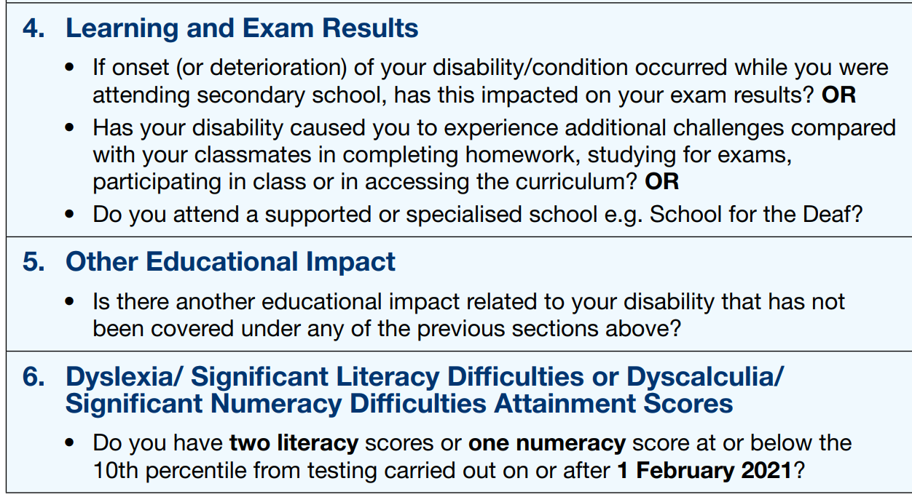
Meeting DARE’s Educational Impact Criteria
Applicants must meet a combination of *two indicators
* Applications with Specific Learning Difficulty must meet indicator 6 + one other. All others any two indicators.
Notes:
Page 3 handout

Slide 79
IMPORTANT
HEAR/DARE Applications are embedded within the CAO application, if you do not tick on the relevant box, within the CAO application, you will not gain access to the HEAR & DARE applications.
The information appears after the Qualifications Sections in the CAO application
Disability
If you wish to disclose a disability or Dyslexia/ Significant Literacy Difficulties or Dyscalculia/ Significant Numeracy Difficulties or apply to the Disability Access Route to Education (DARE) click on the
'Modify Disability (& DARE Application) Status' button below.

Slide 80
Higher Education Access Route (HEAR) (Further Information ) (for school-leavers from socio-economically disadvantaged backgrounds) The Higher Education Access Route (HEAR) is a third level admissions scheme for school leavers from socio-economically disadvantaged backgrounds. You must complete all relevant Sections (1-8) of the online HEAR application by 17:00 on 1 March 2025 to be considered for HEAR
Click on the HEAR Application button below to complete your online HEAR application.
SUSI - Maintenance/Fee Grant Application (Further Information) All new student Maintenance/Fee Grant applications will be made online to SUSI (Student Universal Support Ireland) through their website at www.susi.ie (see also www.studentfinance.ie). Please refer to the SUSI web site for details of courses that may be eligible for student grant funding from SUSI.
Online SUSI Eligibility Indicator Thresholds If you wish to apply for a grant, you may indicate this on your CAO online application. CAO will then provide your Identification, Contact and Offer/Acceptance details to the grant authority (SUSI).
.
Notes:
Indicator https://www.susi.ie/eligibility-reckoner-app-irish/

Slide 81
DARE and HEAR Timelines
DARE & HEAR closing date |  | 1 March 2025 at 17:00
Supporting documents closing date |  | 15 March 2025
Notification of eligibility |  | June 2025
Review and Appeals Application |  | Late June 2025
HEAR/DARE offers |  | August 2025
College Orientation |  | Late Aug /Early Sept 2025
Notes:
Page 2

Slide 82
Further Information: www.accesscollege.ie

