Slide 1
Geography

Slide 2
Geography at a national level
Leaving Cert Geography is the second most popular optional Leaving Cert subject in Ireland. Approximately, 27,000 students take LC Geography every year. Of this number, 80% take it at higher level.

Slide 3
Teachers in the Geography Department
Ms.Casey
Ms.O’Connor
Ms.Long
Mr.Hayes
Ms.J O’Dwyer

Slide 4
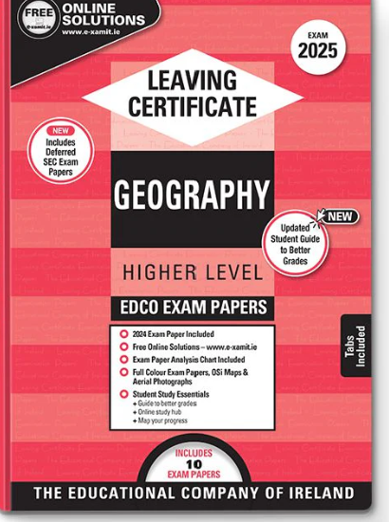

Slide 5
Breakdown of Levels
Leaving Cert Geography consists of four (O.L) or five (H.L) sections which make up the written examination + a fieldwork project. The exam is worth 80% of the marks and the fieldwork is worth 20%.
All students, whether H.L or O.L will submit a fieldwork project, which is handed up in April of the Leaving Cert year.

Slide 6
Topics

Slide 7
Fifth Year Scheme

Slide 8
The written exam
With seven or more essays to be written, timing is crucial in the written exam
The examiner will be looking for SRPs (single relevant points) in your essay. An SRP can be described as a "single meaty statement" or a sentence or paragraph with one clear and true point. At Higher level, an SRP is worth 2 marks so a typical 30-mark essay will need at least 15 SRPs.
There is one written paper for both Higher and Ordinary levels, which lasts for 2 hours and 50 minutes.

Slide 9
Revision Plan sample

Slide 11
Exam paper part 1
Here you will find twelve short questions and you will be marked out of your best ten.
This section is worth 80 marks and should take you less than 25 minutes to complete.
Worth 16% in Higher Level
Worth 20% in Ordinary level

Slide 14
Exam Papers layout part 2
This section has essay-style questions where you have a choice of ONE question from three in each section. Spend no more than 30 mins on each question (80 marks).
Section 1: Physical Geography (Q1, Q2, Q3 - Pick one)16%
Section 2: Regional Geography (Q4, Q5, Q6 - Pick one)16%
Section 3: Human Elective (Q7, Q8, Q9 - Pick one) OR Economic Elective (Q10, Q11, Q12 - Pick one)16%
Section 4: Options (Questions 13-24) - Higher level only. Choose one of 4. Each question will require you to write a single longer essay where you discuss three or four aspects of the theme in detail in 30 minutes (80 marks)16%

Slide 15
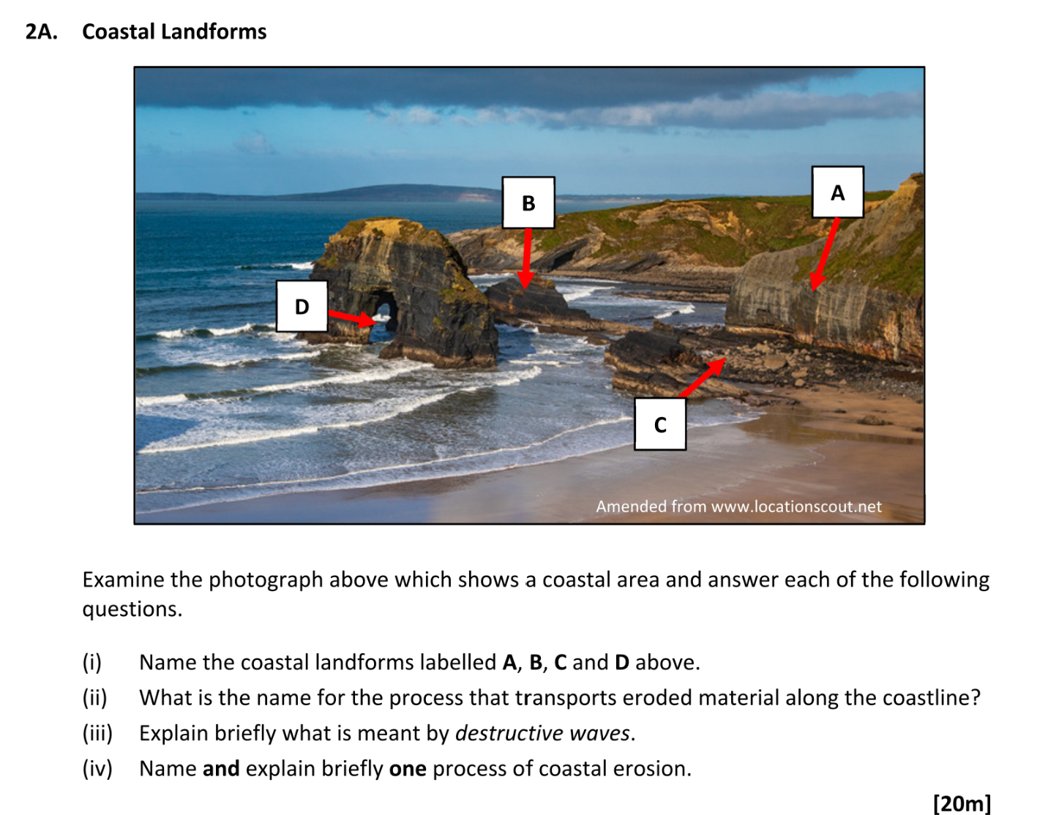
20 Mark question

Slide 16
30 Mark question

Slide 17
Project
River investigation
Worth 20% for both levels
Group activity-Individual written booklet
Fieldstudy completed in September-due April of 6th Year.

Slide 18
Cross Curricular
Geography links in with Biology, Maths, Economics and the new subject climate action and sustainable development

Slide 19
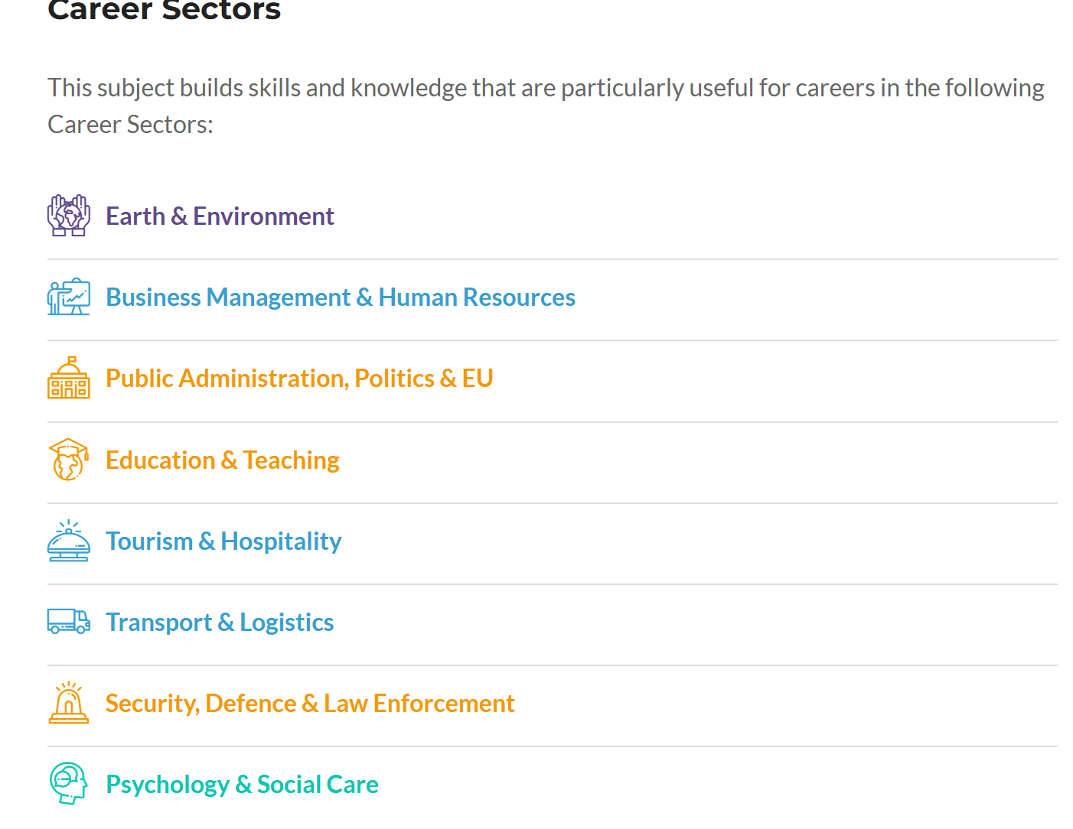

Slide 20
Common Questions
Do you need to have done Junior cycle Geography?
Is there a lot of writing?
How much is the project worth?
What’s the style of learning in the classroom?
Do we get to go on fieldtrips/guest speakers?

