Slide 1
Leaving Certificate Accounting
By Ms. Kinane

Slide 2
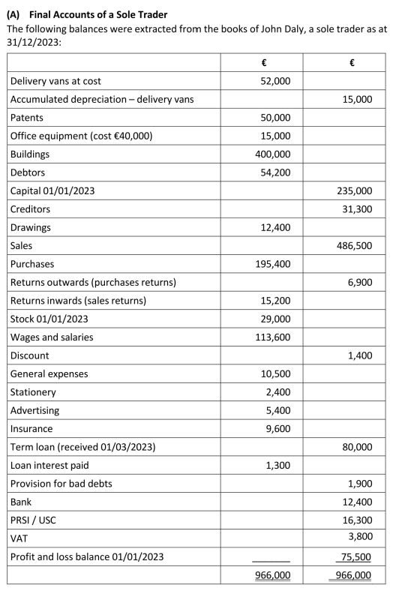
What is Accounting?
It is the process of
recording,
classifying,
summarising, and
analyzing financial information.

Slide 3
Importance of Accounting
Tracks financial information
Aids decision making
Provides transparency

Slide 4
Why study Accounting?
Develops valuable skills:
Analytical thinking
Problem-solving
Attention to detail
Prepares for careers in finance, business, and entrepreneurship

Slide 5
Assessment Overview
100% Written Exam
3 hours
Both higher & ordinary levels

Slide 6
Course Structure
Section A & B : Financial Accounting
Section C : Management Accounting
Section A – 120 marks 30%
Section B – 200 marks 50%
Section C – 80 marks 20%

Slide 7
Topics include
Bank Reconciliation Statements
Control Accounts
Depreciation
Revaluation
Farm Accounts
Club Accounts
Service Firm Accounts
Incomplete Records
Suspense Accounts
Section A – 30%
Choose either one long 120 mark question or
complete two short 60 marks questions.

Slide 8
Topics include
Control Accounts
Farm Accounts
Club Accounts
Service Firm Accounts
Incomplete Records
Suspense Accounts
Interpretation of Accounts
Published Accounts
Section B – 50%
Choose two from three 100 marks questions.
*Q5 each year is guaranteed Interpretation of Accounts
(*therefore you know 25% of paper in advance)

Slide 9
Topics include
Marginal Costing
Absorption Costing
Job Costing
Budgeting
Cash Budgeting
Product Budgeting
Section C – 20%
Choose one from two 80 mark questions.
Management Accounting

Slide 10
Skills you’ll gain
Understand financial statements
Budget preparation and management
Solving real-world financial problems
Effective data analysis and reporting

Slide 11
Careers in Accounting
Accountant
Auditor
Financial Analyst
Tax Consultant
Business Owner/Manager/CEO
Pathway to professional qualifications eg ACCA, CPA, CIMA.

Slide 12
Tips for success
Practice regularly with past exam papers
Develop a solid understanding of basic concepts
Stay organised and manage time effectively especially during exams

Slide 13
Who should study Accounting
Do you like working things out? Have you a logical mind? Do you like to know your answer in advance? Are you organised? Do you pay attention to details? Do you like working with numbers? Are you interested in finance, business management or entrepreneurship?

Slide 14
Difference between HL & OL
Extra topics are examinable at HL only
OL Paper can be decided in advance of sitting the exam – know the questions definitely on the paper.
More detailed and in-depth adjustments/calculations required at HL.
No theory on OL paper – 10% on HL paper.

Slide 15
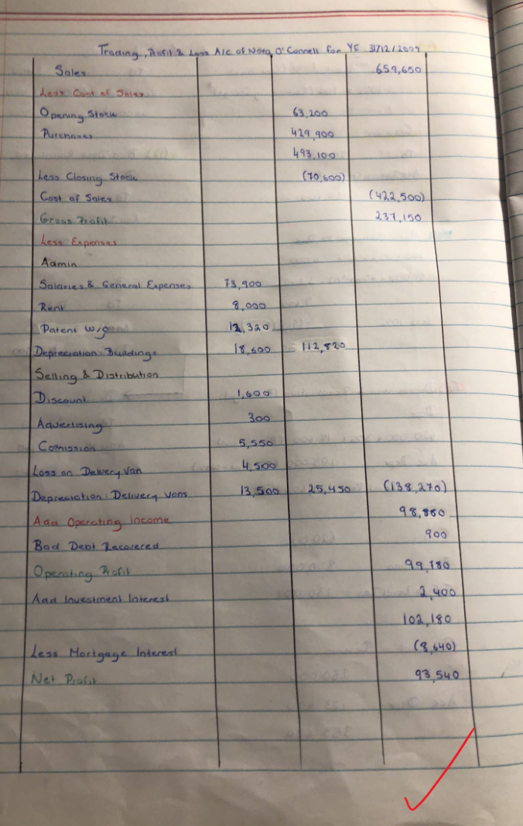
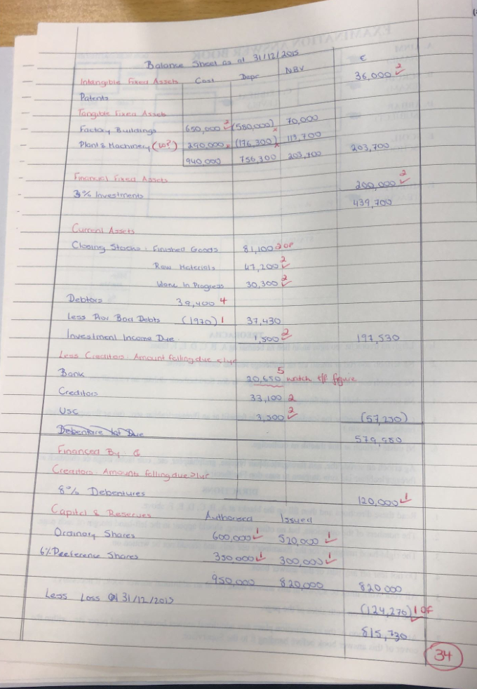

Slide 16
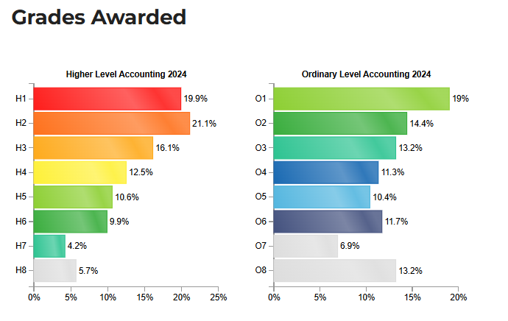
Notes:
St. Ailbe’s Grades in 2024 – of those taking HL 50% H1’s
of those taking OL 100% O1’s.

Slide 17
Accounting in Everyday Life
Budgeting – personal income & expenses
Shopping – understanding discounts, sales and taxes (VAT)
Paying bills
Banking – monitoring balances, loans and interest rates
Running a business – profits/costs/stock
Setting goals for savings, investments and retirement!!

Slide 18
THANK YOU

