Slide 1
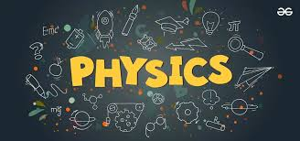
Leaving Certificate Physics

Slide 2
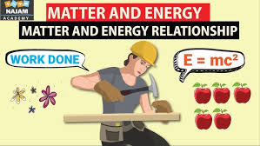
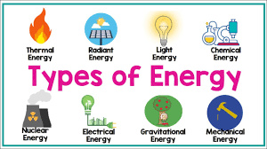
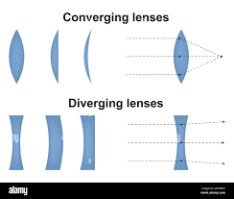
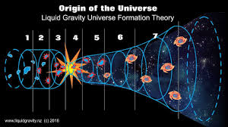
Physics is the study of Energy, Matter and how they interact.

Slide 3
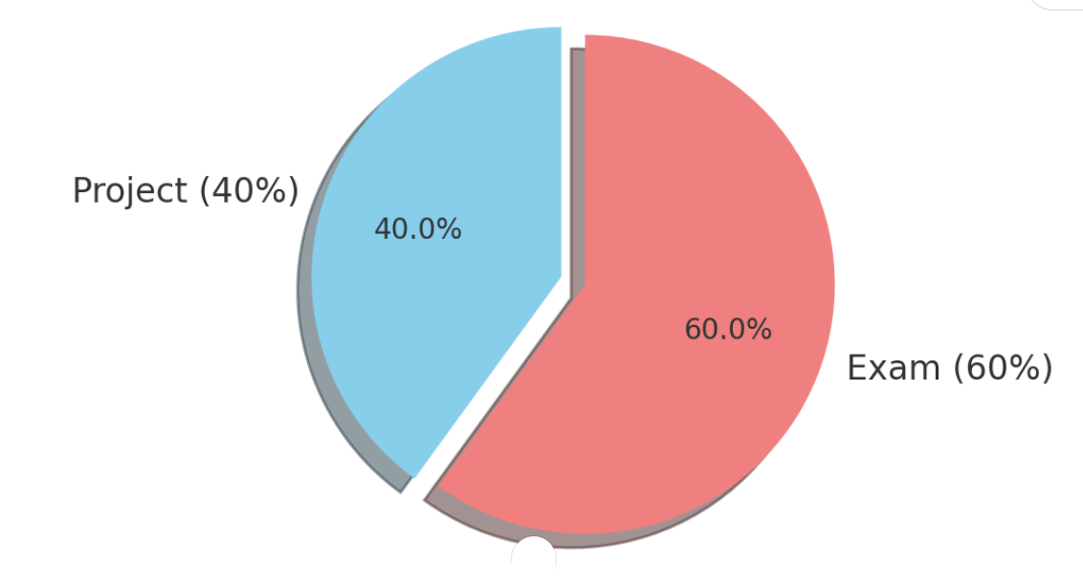
EXAMINATION SPLIT
40% Project. Receive a brief with guidelines and must carry out experiment to satisfy the brief and guidelines.
60% Final Exam. This is a combination of short answer questions, experimental questions and long answered questions.

Slide 4
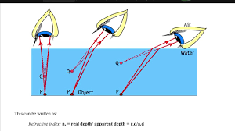
Physics overview
There are 6 units in leaving certificate physics. Each unit contains many different sub units and chapters.
Optics
Forces and Motion
Waves and Energy Transfer
Heat and Heat Transfer
Electricity and Magnetism
Modern Physics

Slide 5
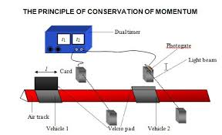
Experiments
Currently there are 24 practical activities that students must carry out.
Experimental questions appear every year in the Physics paper.

Slide 6
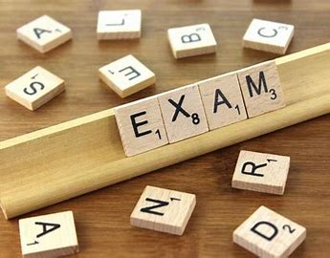
THE EXAM
Currently the Physics exam layout is:
Section A Experiments – Answer 3 out of 4 questions. (90 marks)
Section B Theory – Answer 5 out of 8 (310 marks)

Slide 7
The PROJECT
In term 2 of 5th year students will receive an investigative brief from the SEC.
This allows students to develop their own thinking and ideas on areas they would like to explore in relation to the brief. Students will design an appropriate investigation to explore this particular area.
Students are also required to carry out scientific research and an experiment on an issue within the brief.
Students will receive headings and guidelines for their experimental write up and will receive guidance from their teacher.
Students will design their own investigation.

Slide 8
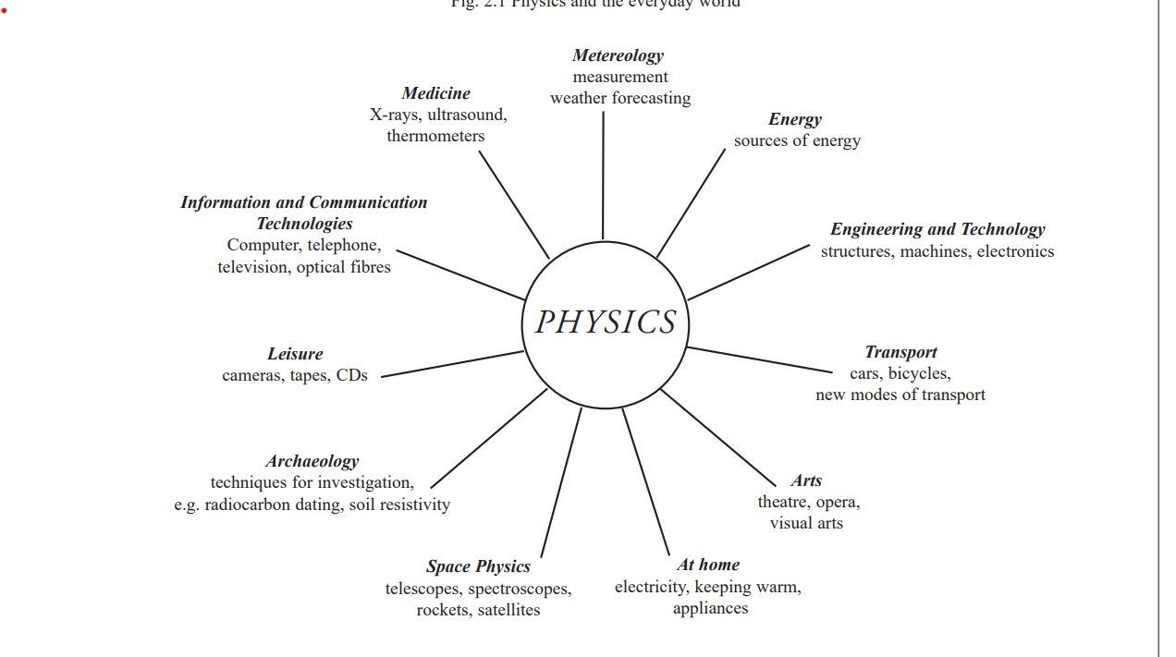
Physics in Everyday Life
Medical Applications: Ultrasound, X-rays
Transportation: Physics principles guide car safety
(e.g., crumple zones, airbags) and aviation (e.g., lift, thrust).
Sports: Understanding motion, force, and energy helps
improve athletic performance and sports equipment design.
Space Exploration: Rockets, satellites, and space probes rely on mechanics, thermodynamics, and electromagnetism.

Slide 9
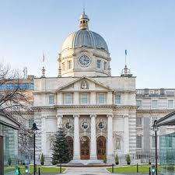
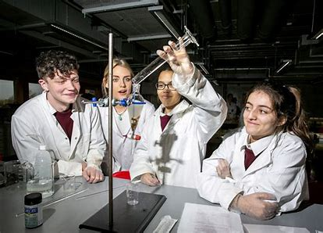
Physics TRIPS
The Institute of Physics (IOP) is the professional body and learned society for physics in the UK and Ireland, with an active role in promoting co-operation in physics around the world / Biomechanics Labs
In 6th year students go on a day trip to the University of limerick where they will set up and carry out experiments on the syllabus. This provides students the opportunity to revise experiments and also working with others and learning from each other.

Slide 11
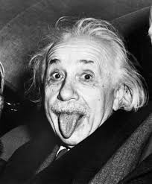
Food for Thought
We Don’t Fully Understand (~95%) of the Universe. Imagine if you were one of the next Einsteins of the 21st Century?

