Slide 1
Senior Cycle Art & Visual Studies

Slide 2
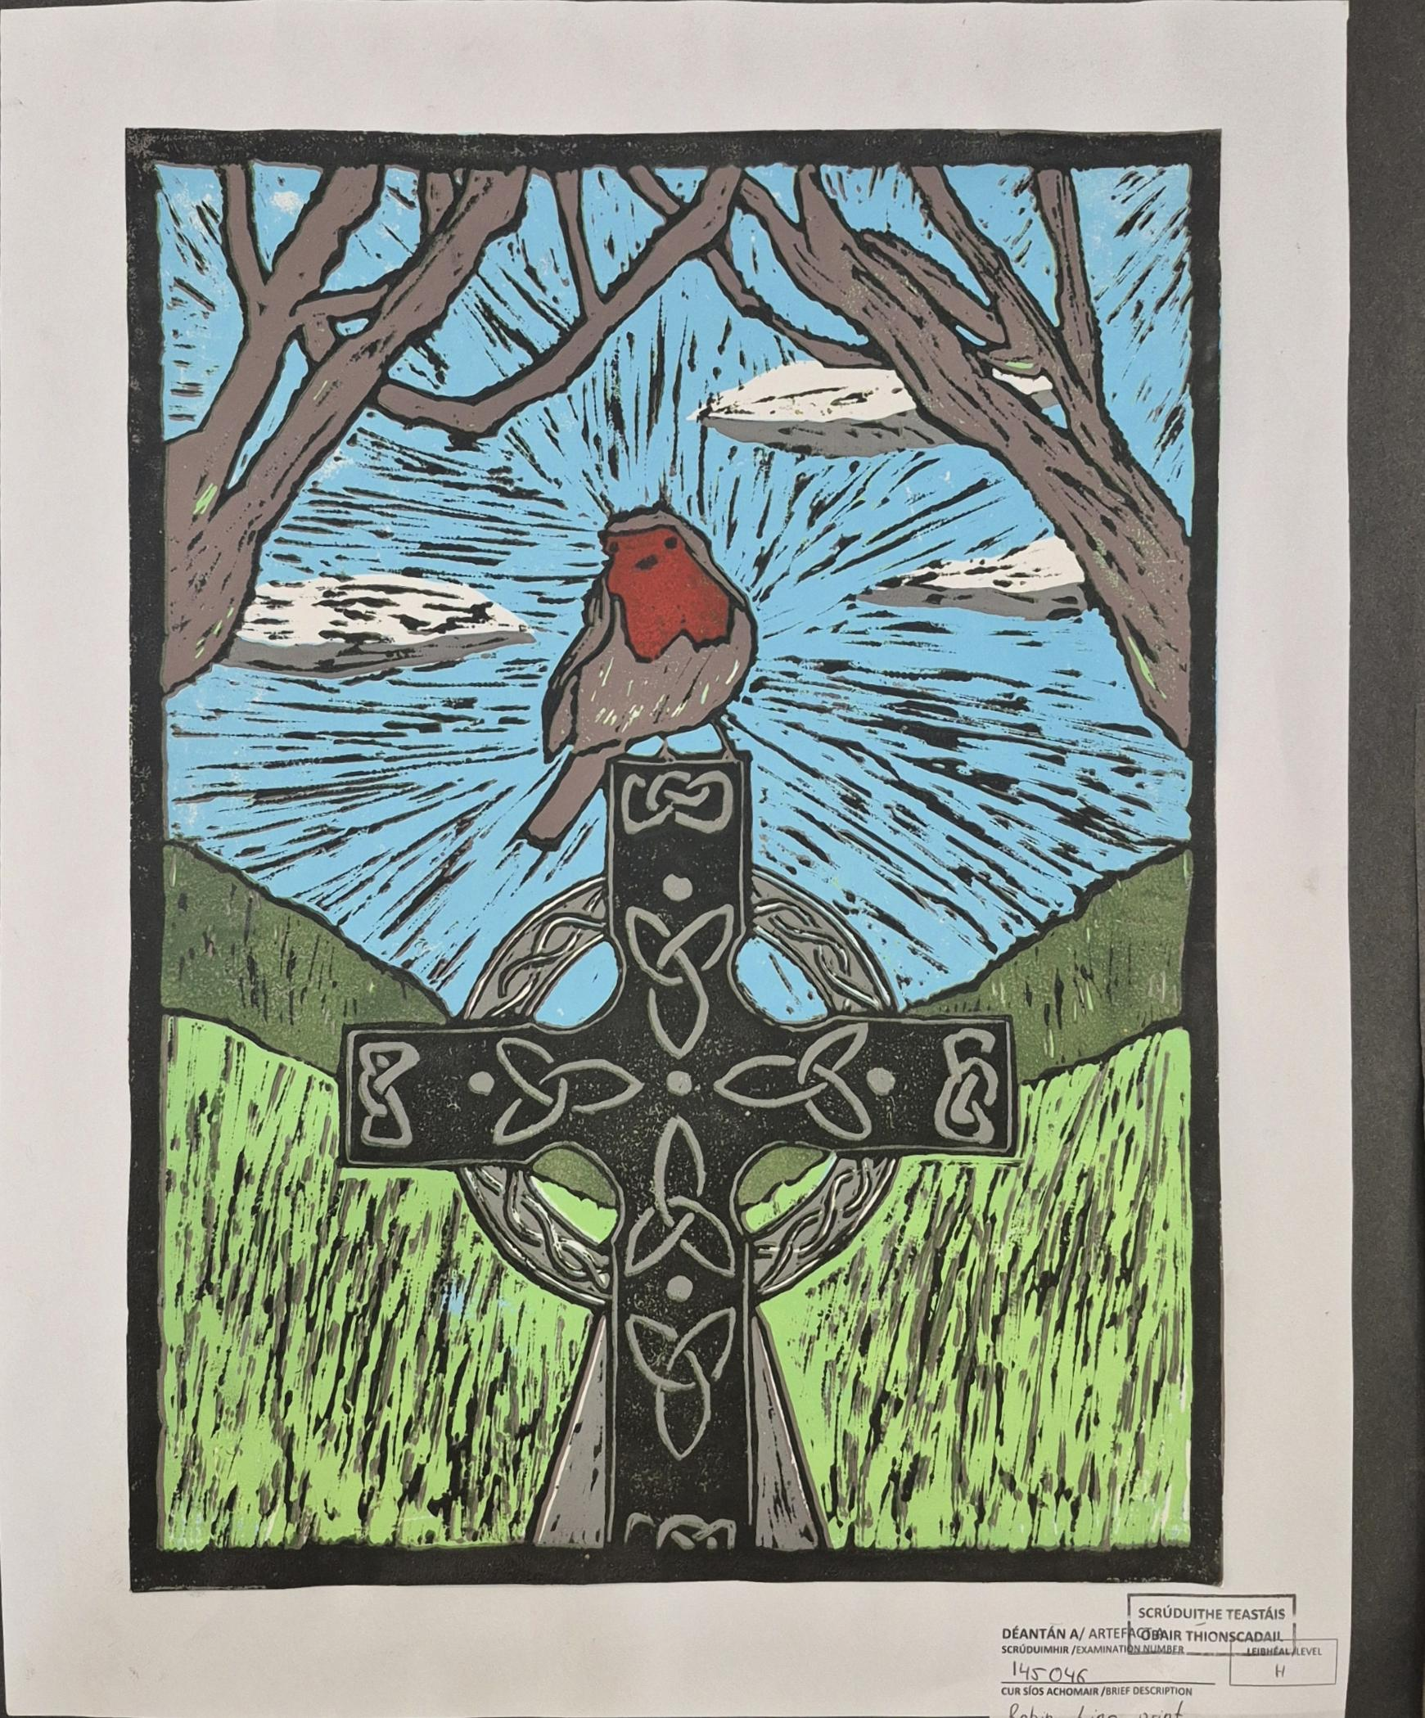
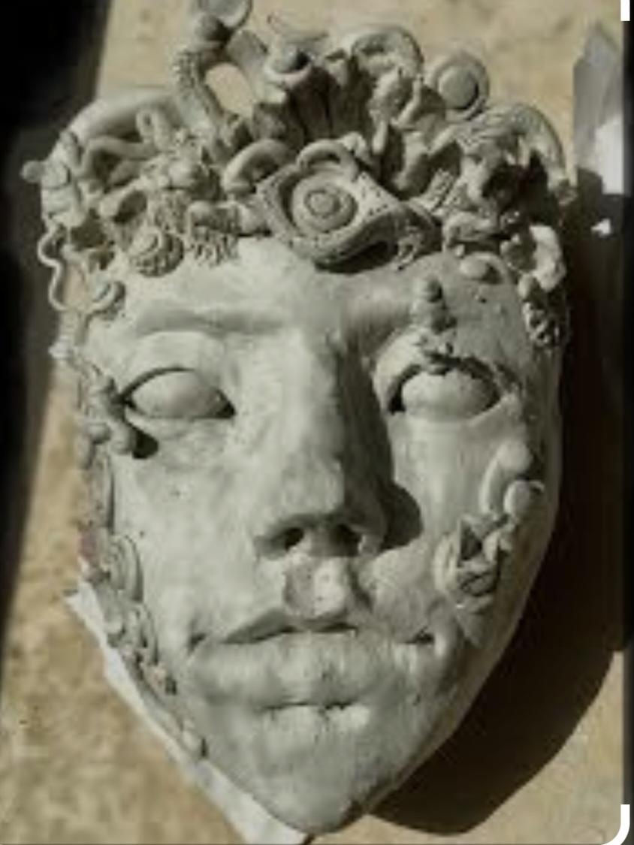
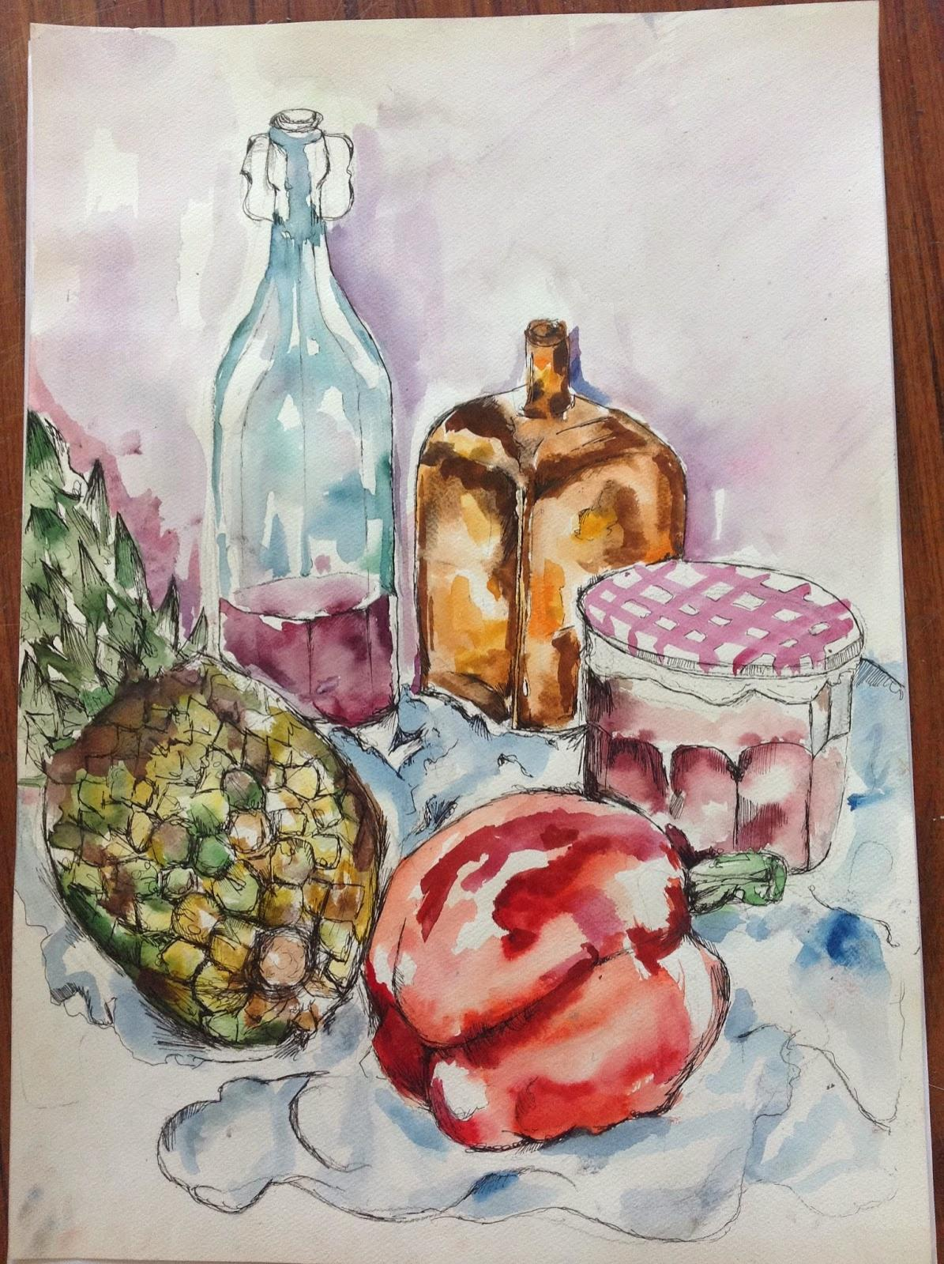
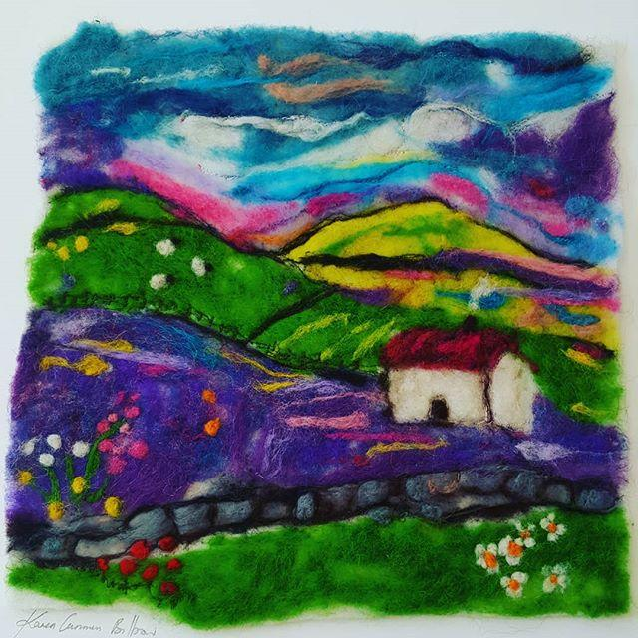
Art is examined in three ways:
Practical Coursework – 50% of marks
Practical Examination – 20% of marks
Written Examination – 30% of marks

Slide 3
Practical Project- 50%
A brief is distributed in December of 6th year
Students work on a practical project for approx. 12 weeks during class time
All work is completed in a Visual Journal- workbook
Artefact A is created during this time in class and preparation for Artefact B is also completed.

Slide 4
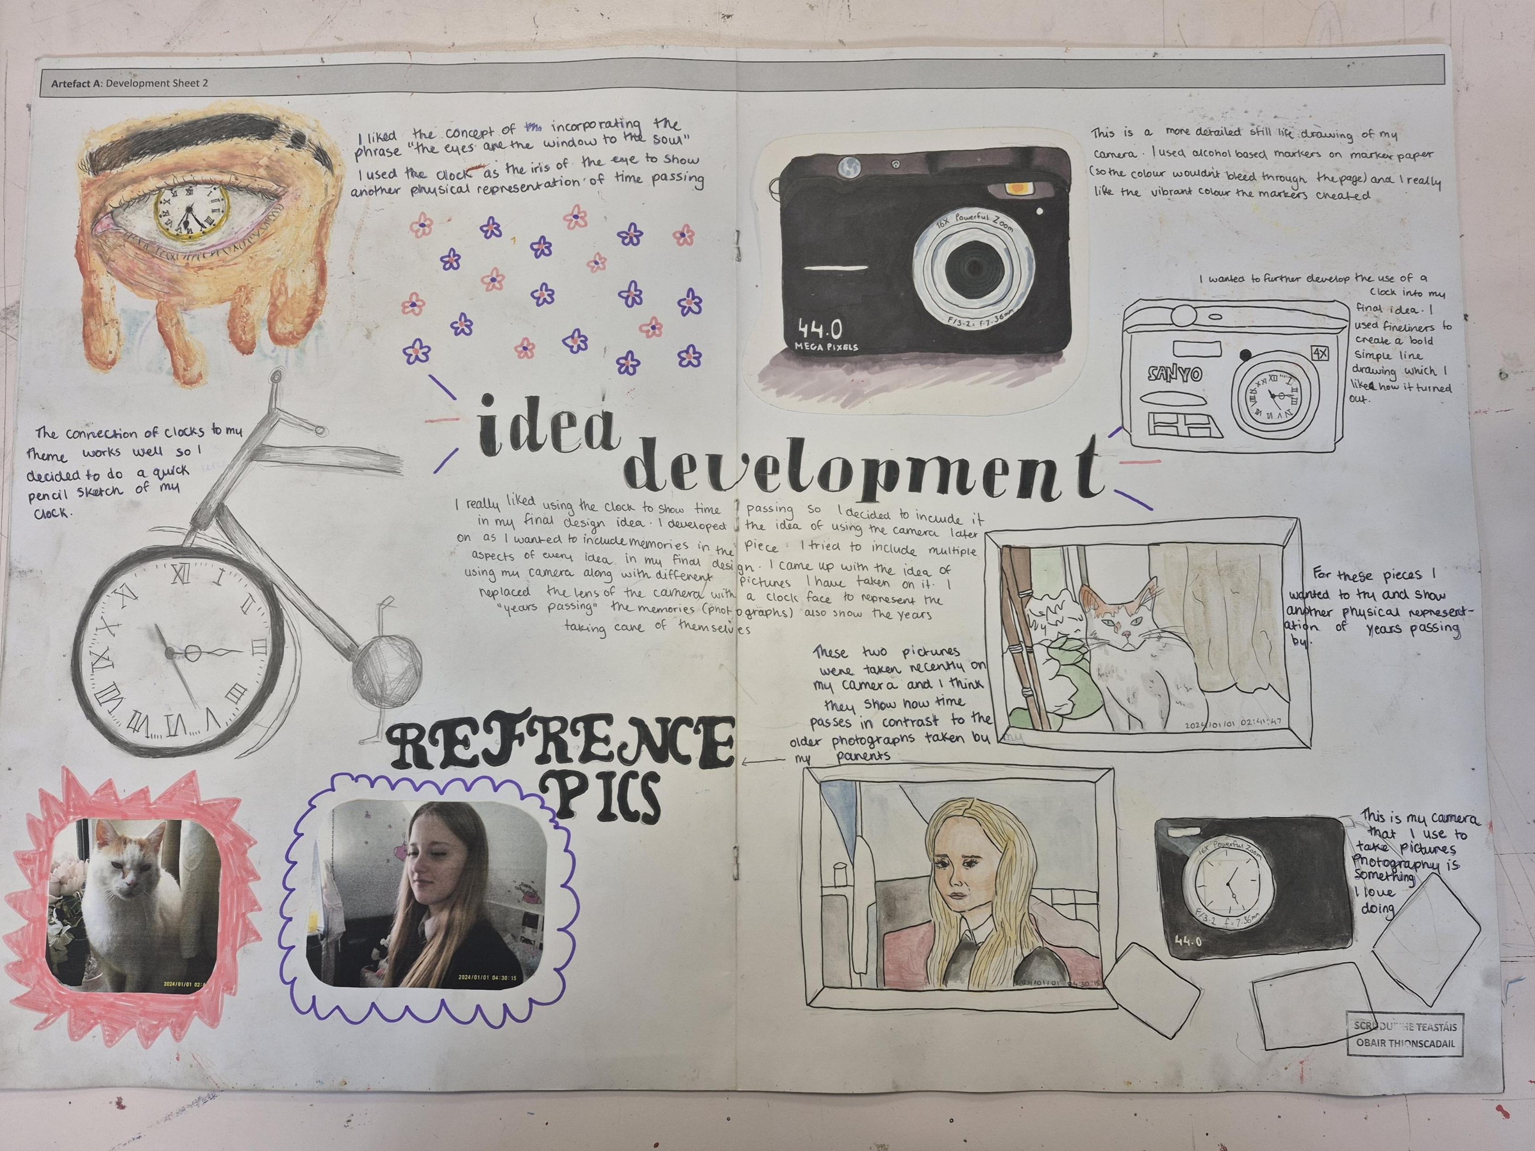
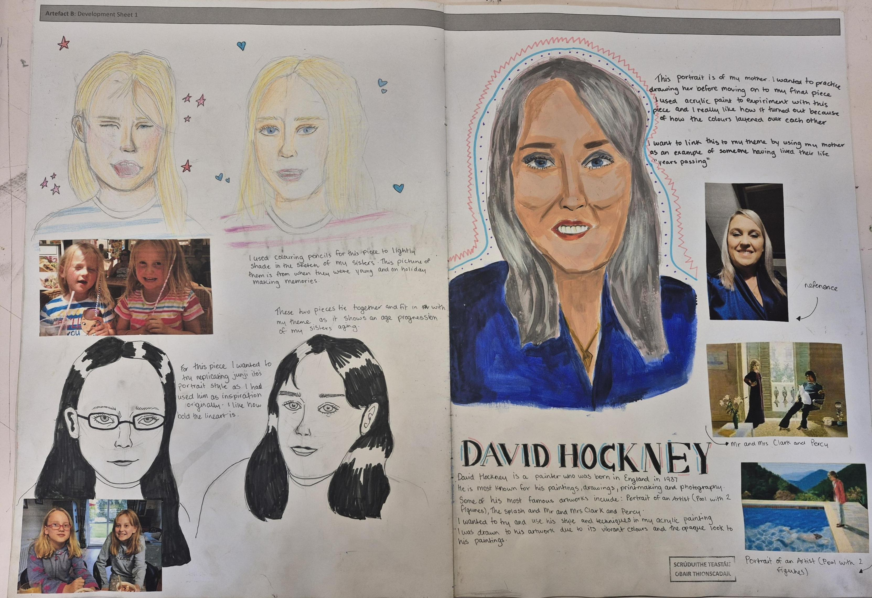
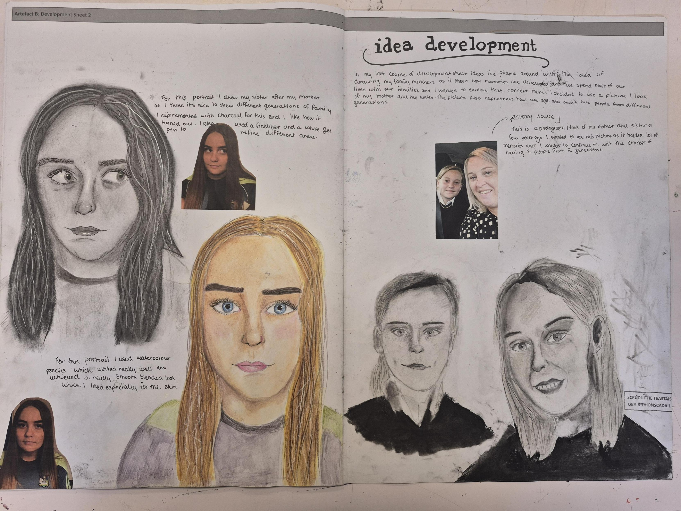
Practical Exam 20%
The practical exam takes place in April of 6th year
Students have 5 hours to complete Artefact B – all prep work completed in class beforehand

Slide 5
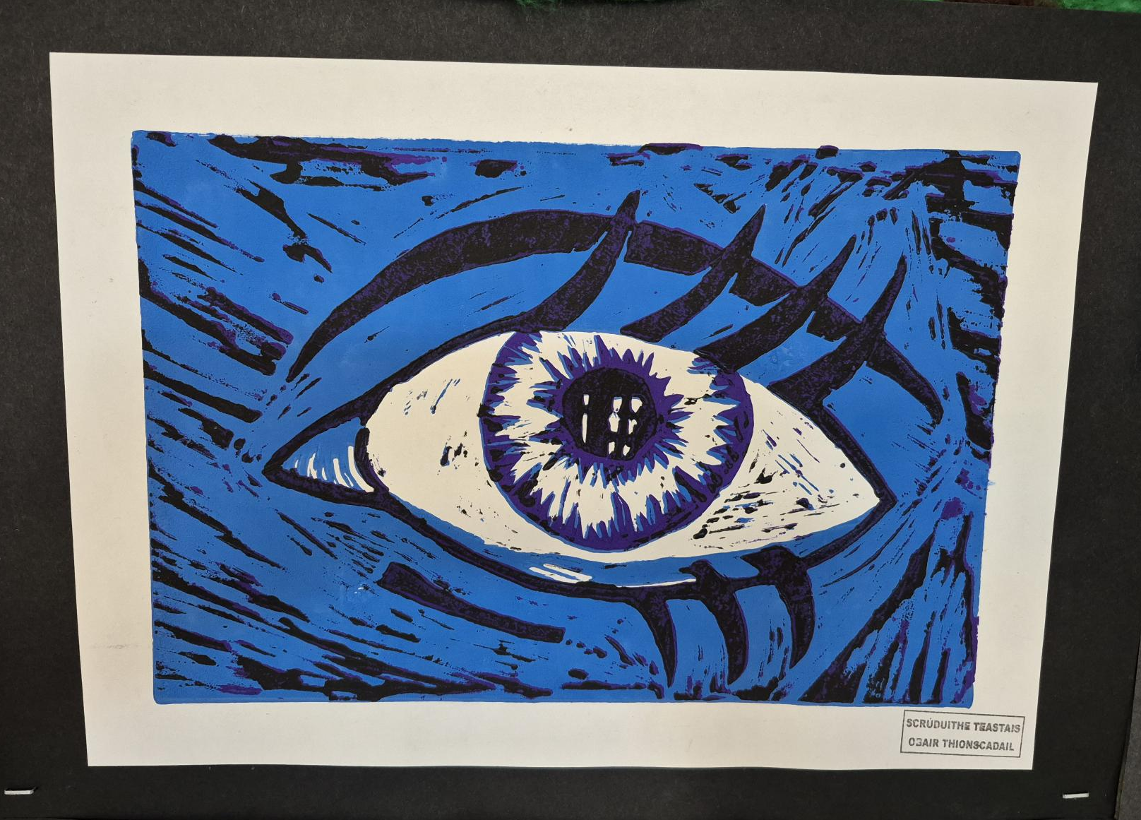
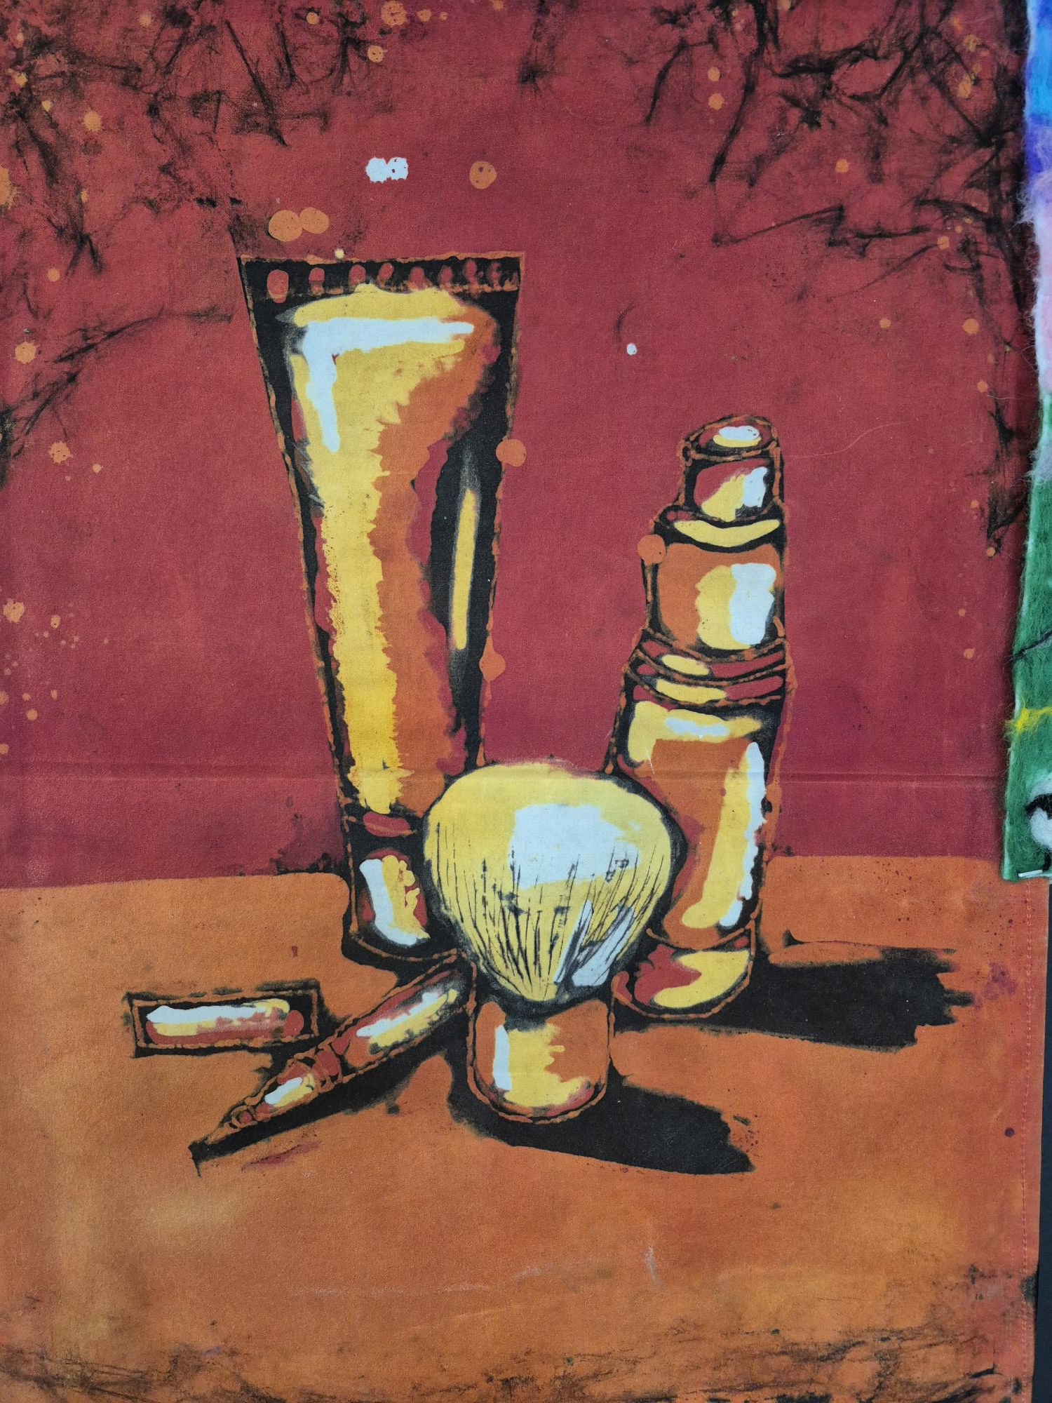
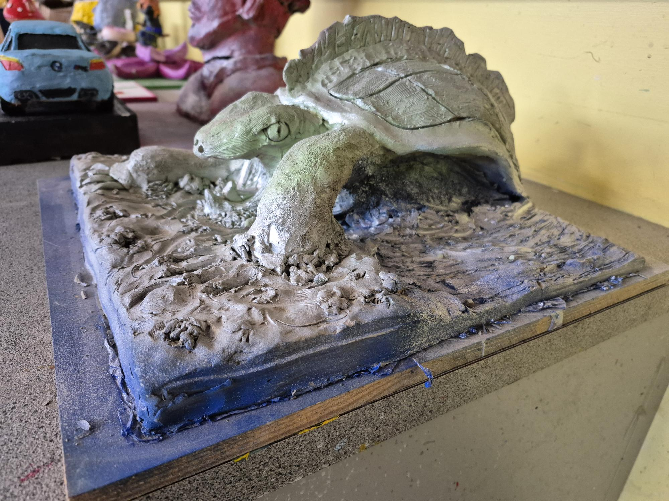

Slide 6
Written Exam 30%
A written exam is completed in June of 6th year
This is a 2.5 hour exam that focuses on the 3 areas o study
Section A- Today’s World (short questions)
Section B- Europe and the wider world (One long question)
Section C- Ireland and its place in the wider world (One long question)

Slide 7
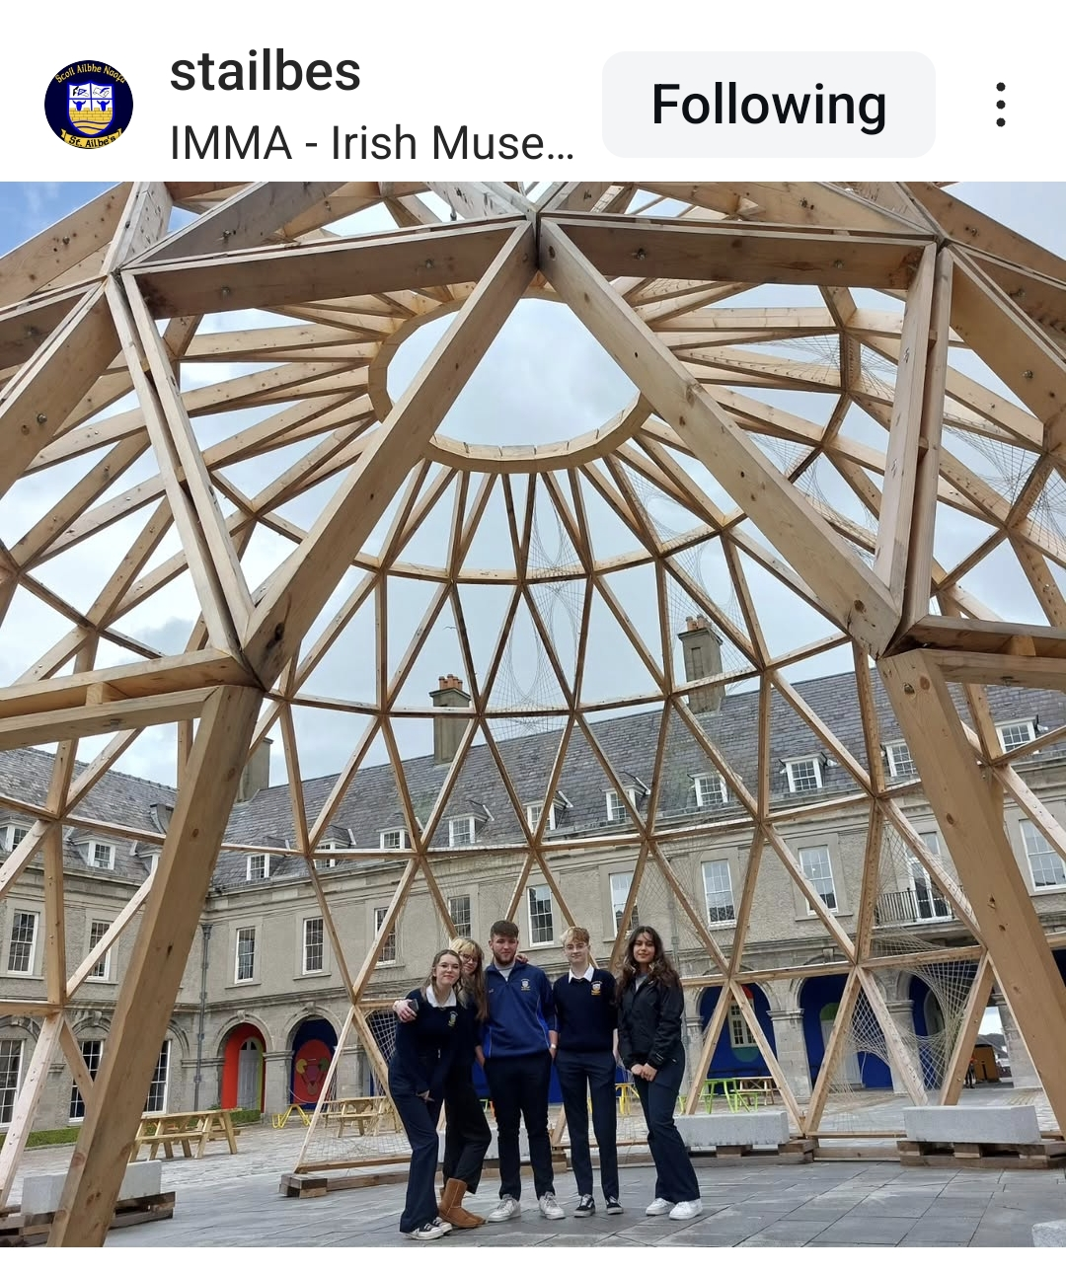
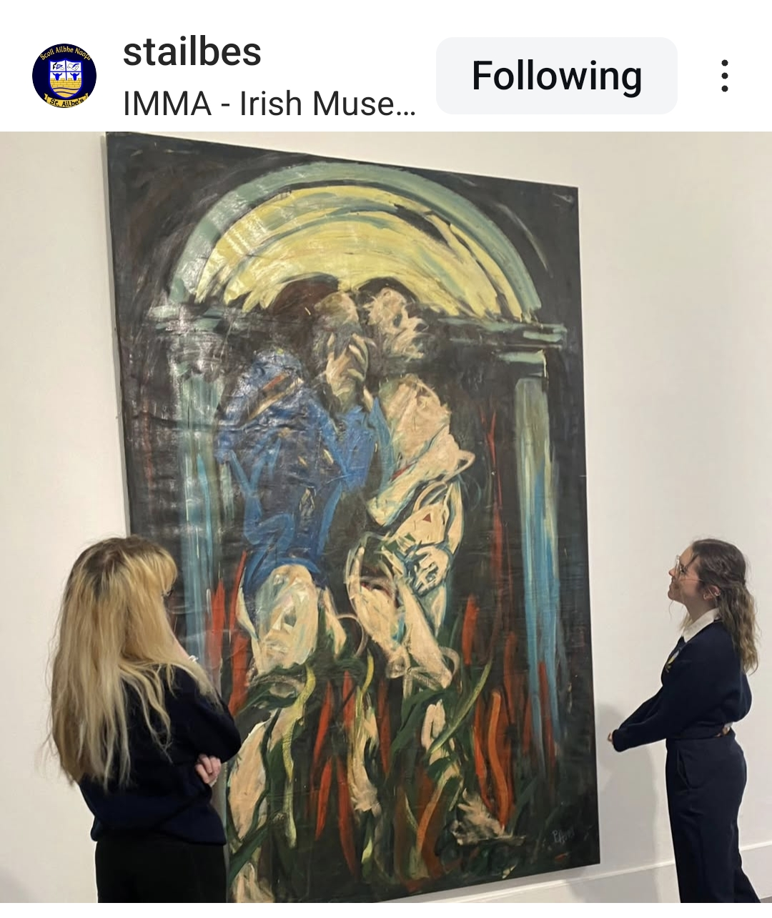
Who should consider taking on Art at Senior Cycle?
Anyone!
You do not need to have done Art for Junior Cycle- once you have an interest and are willing to learn Art is a fantastic subject!

Slide 8
What do we do in class?
We divide our classes into Practical classes and Art History (Visual Studies) classes.
In practical classes we learn to draw, analyse themes and explore different crafts.
Crafts include- Lino printing, Etching, Batik, Painting, Clay sculpture, Needle Felting, Plaster Casting and more.
Art is a busy and sometimes messy subject!
But always CREATIVE!

Slide 9
Visual Studies
Art History might seem daunting but we only study a taster over 5th year and 6th year.
We specialise in a European and Irish period of art, while also looking at art in Ireland today.
We also go to Dublin each year to visit The National Gallery of Ireland or The Irish Museum of Modern Art.
We do not use a textbook- all notes are available on Sharepoint- here we use powerpoints for each topic with some homework questions.
https://stailbesschool.sharepoint.com/sites/ArtVisualStudies?spStartSource=spappbar

