Slide 1
Transition Year at St. Ailbe’s

Slide 2
Admission to the programme
We have currently 76 students enrolled in the TY programme.
Students are invited to attend for a brief interview in April ( after the Easter holidays)
Students will be given an assigned interview time.
Following the interview, the students will be asked to sign a contract, committing to full participation in TY.
The purpose of the interview is also to establish what the students would like to achieve in the course of the year
Prospective students must have a good record of attendance, punctuality and behaviour
Students must have shown the ability to meet deadlines and complete assignments and project work
It would also be an advantage if the student has made a positive contribution to school life in their involvement with extra- curricular activities.

Slide 3
AILBES
In the course of the interview, I outline to students that I use the letters of Ailbe’s to represent some values that I feel are important to TY students
A – Attendance
I – Involvement and Interaction
L - Learn
B – Behaviour
E - Extra-Curricular Activities
S - Self -motivation

Slide 4
The TY Programme
We build upon our list of activities each year. We also invite students’ input and suggestions too.
Here are some but by no means all of the activities and courses we complete….
September-October
School Musical
TY Comedy Show in Thurles
Collection for The Irish Wheelchair Association
Guest Speaker from Cliona’s Foundation
Camino for Cliona’s
Gaise – The President’s Award

Slide 5
TY Activities
November-December
Work Experience Week 1
The Abbey and St. Anne’s Panto
Barista
Templemore 3 day course
First Aid
St. Mary’s Community Food Bank fundraising and preparation of hampers
Ice-skating trip to Limerick

Slide 6
Activities continued:
Carol singing
LawEd Workshop
Christmas Wreath- making workshop
TY Christmas Breakfast
Glen Vets TY Academy

Slide 7
TY Activities
January-February
Driving lessons
Jiving
RSA Road Safety Matters – preparation of questions for the Theory Test
TY Show in Thomond
Work Experience Week 2

Slide 8
TY Activities
March-April
Driving
Barista
Trip to Barcelona at Easter
Work experience Week 3

Slide 9
TY Activities
May
Ballyhass/ Gaisce Trip
End of year trip to Spike Island
TY Graduation

Slide 10
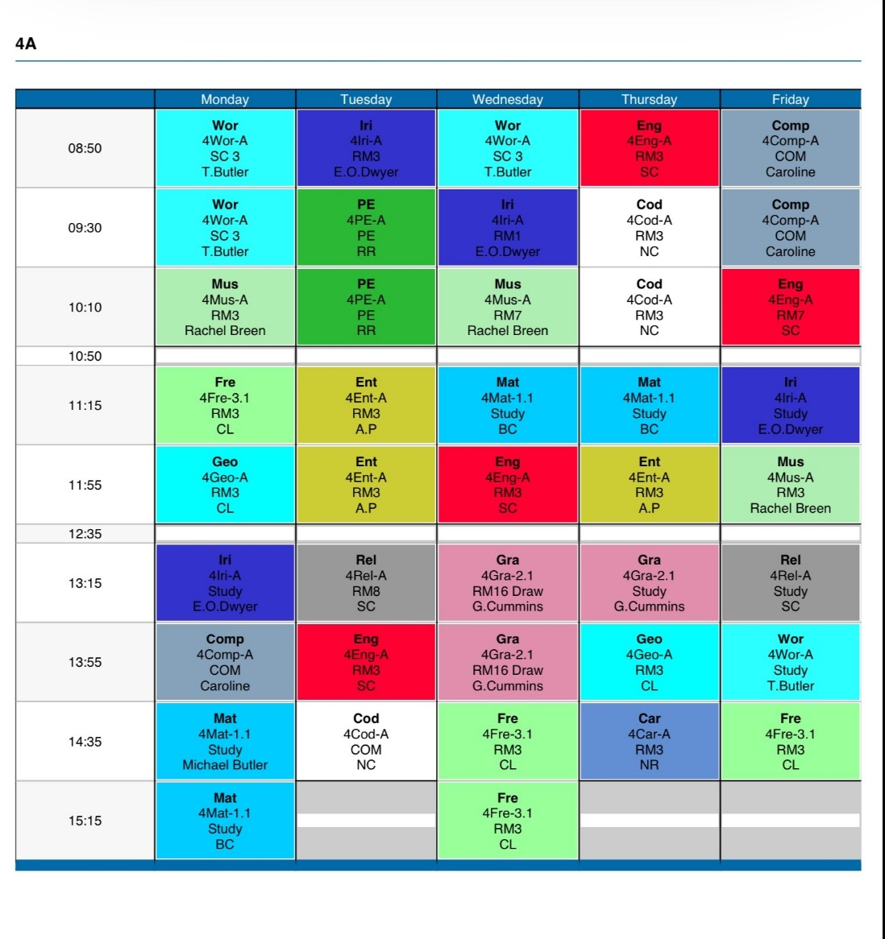
A look at an example of a TY timetable

Slide 11
Cost
The fee for TY is the same as other academic years, €150.
Although students will not have textbooks in all subjects, this cost covers photocopying, class materials and heavily subsidised activities and workshops
Other costs include activities and optional extras like the school tour at Easter, driving lessons, ice skating trip to Limerick and Ballyhass Outdoor Activity Centre
Some activities incur a fee for day trips. This includes the entrance fee and the bus.
A number of workshops are free and other trips are subsidised

Slide 12
The Benefits of doing TY
It may sound like a cliché but you get out of TY what you put in. That is to say that the more activities you get involved in and the greater the effort you make, it will be an enriching year and highly beneficial.
Students learn to work independently and also as part of a group
They become more confident and generally their communication skills will improve through work experience, involvement in the school musical and engaging with the various guest speakers.
It is an extra year to mature
A lot of the courses and workshops we do are certified or at least student participation is recognised
Students gain an insight into the world of work. This may also influence their subject choices going forward into Fifth Year
Students who approach the year with an open mind and positive attitude will benefit most

Slide 13
I have included a number of photos of some of the activities that we have done so far this year.
We are very proud of their achievements and level of commitment and we are just half way through the year
We still have lots more to pack in
Thank you for your time and I wish you every success in your future studies here at St. Ailbe’s
If you have any further questions, please do not hesitate to contact me claire@ailbes.com

Slide 14
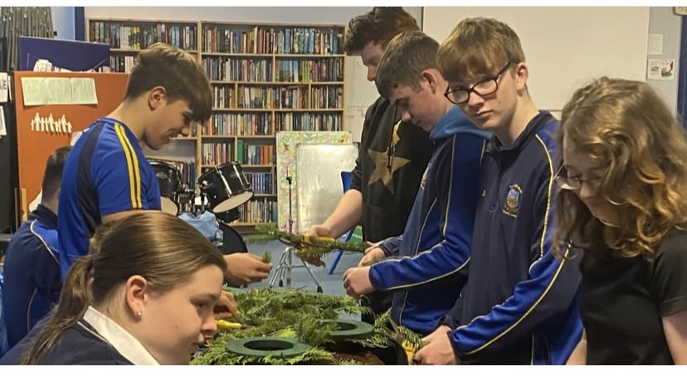

Slide 15
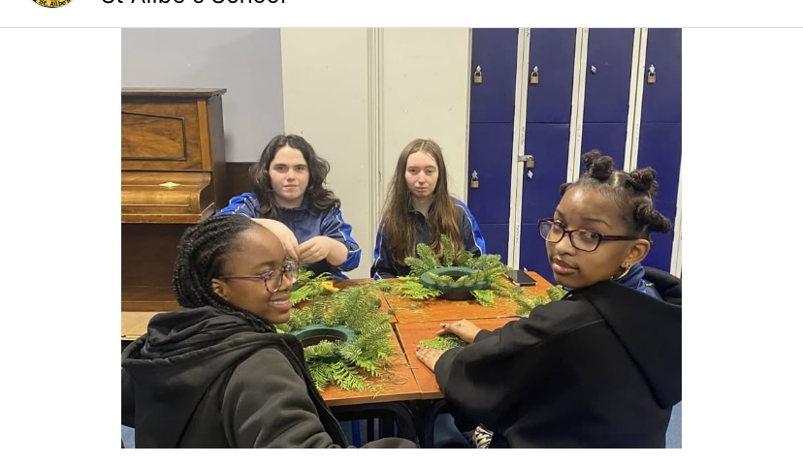

Slide 16
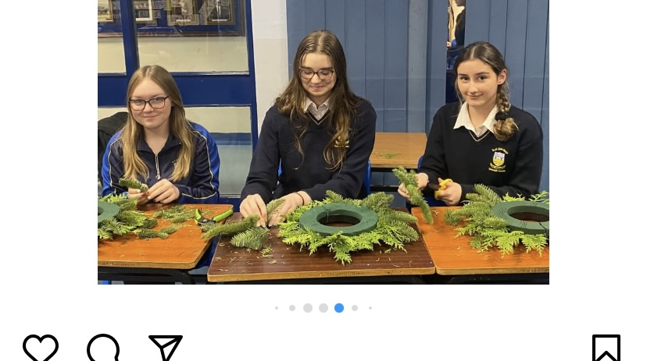

Slide 17
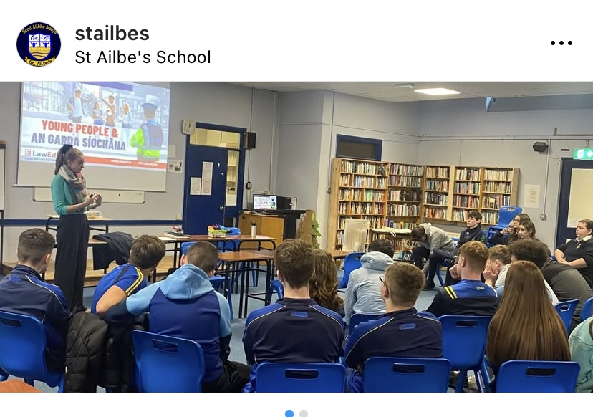

Slide 19
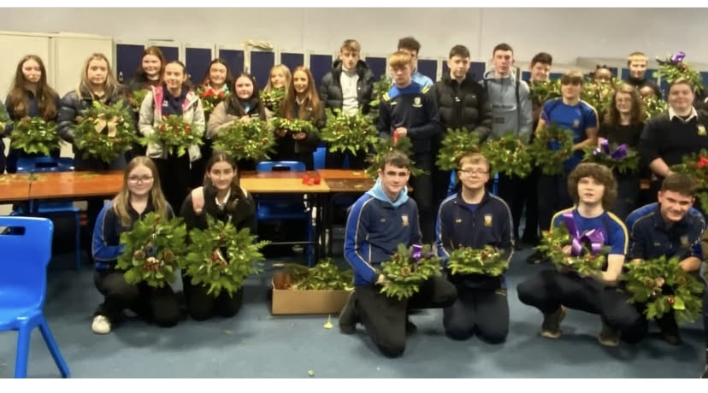

Slide 20
TY Activities

Slide 21
Activities Snapshot

Slide 24
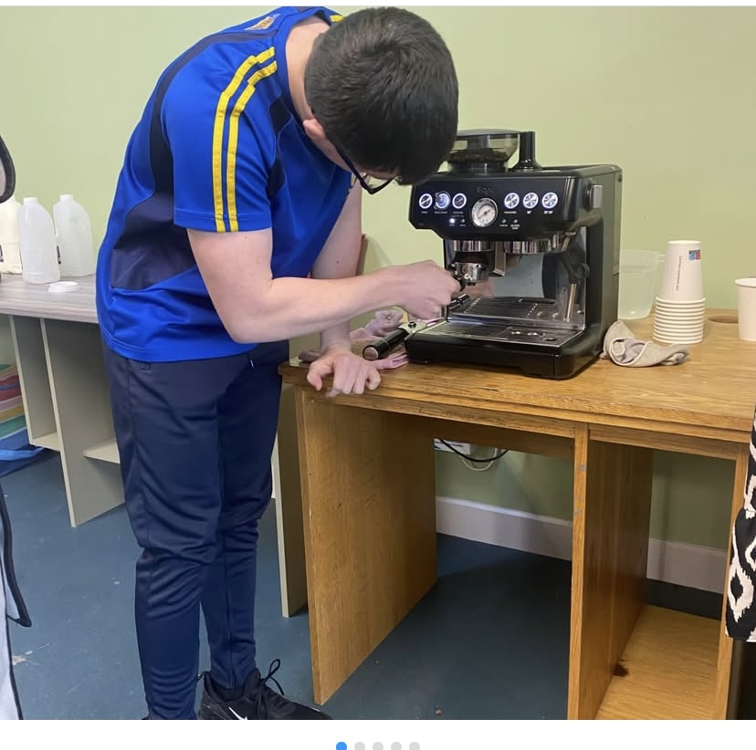

Slide 25
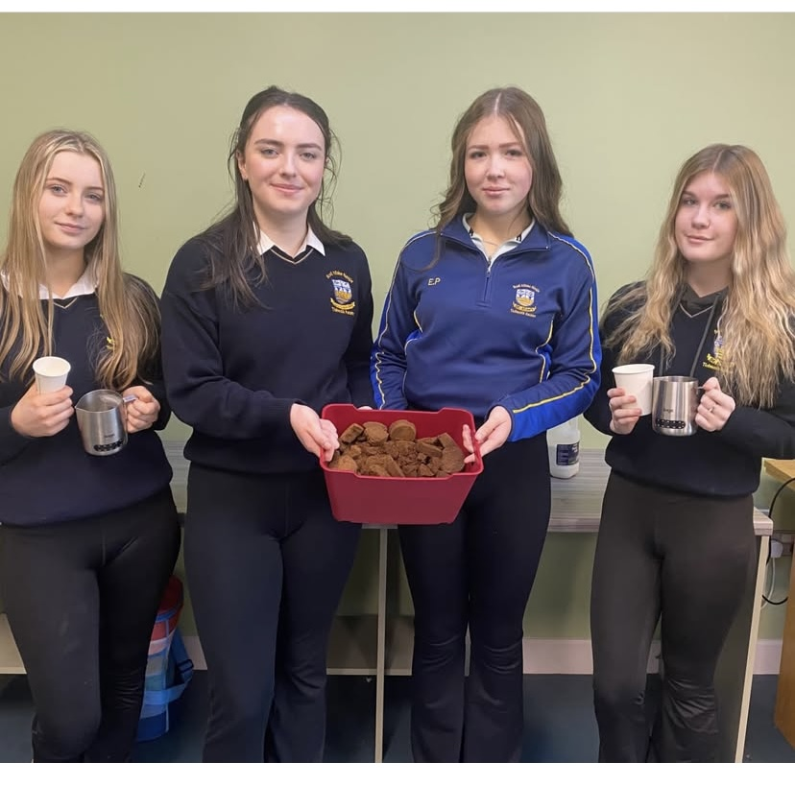

Slide 26
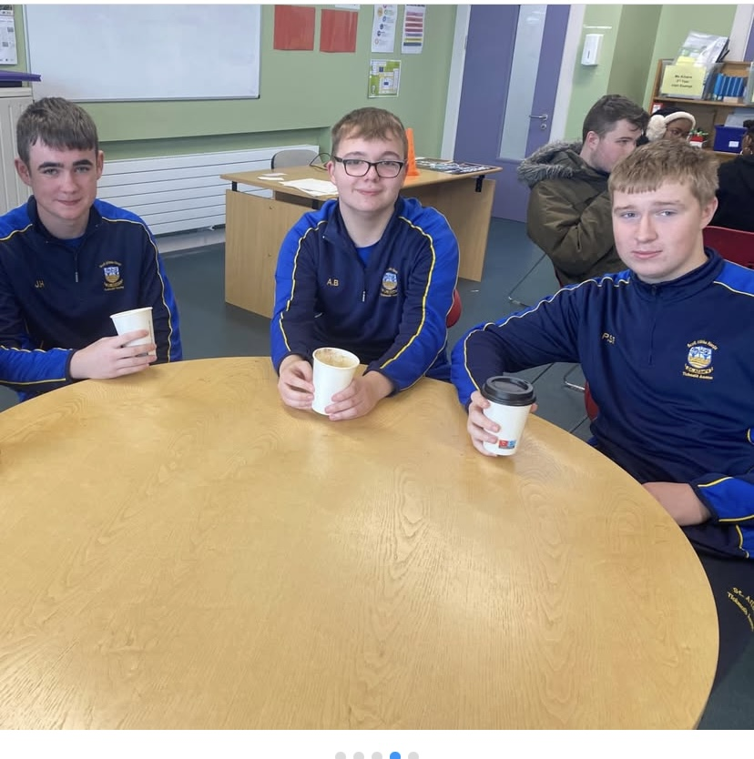

Slide 27
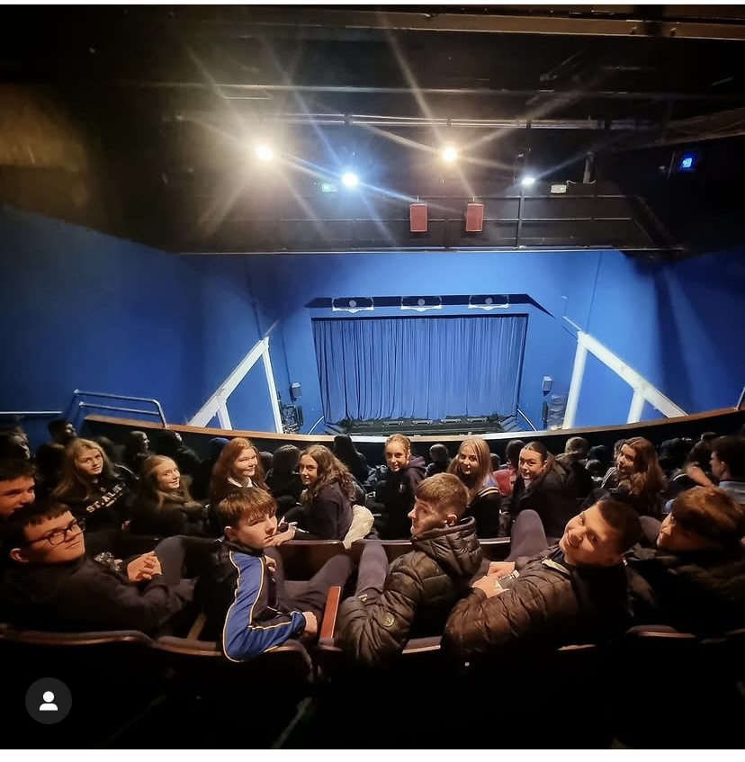

Slide 28
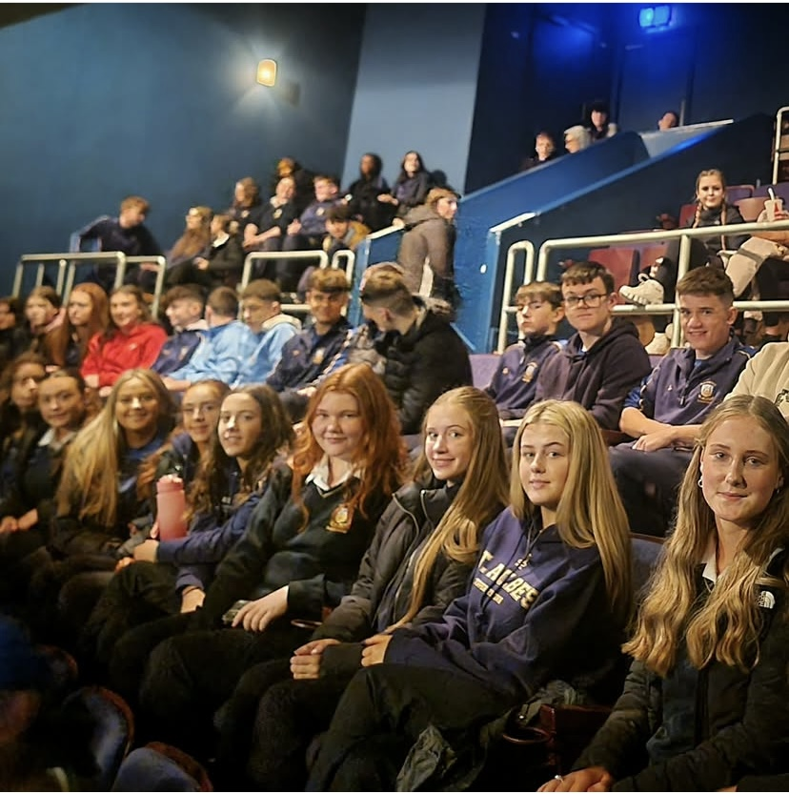

Slide 29
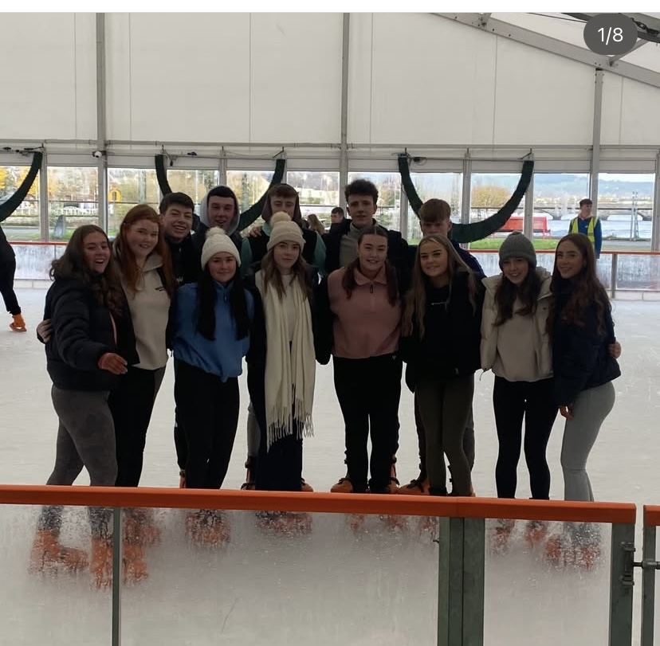

Slide 30
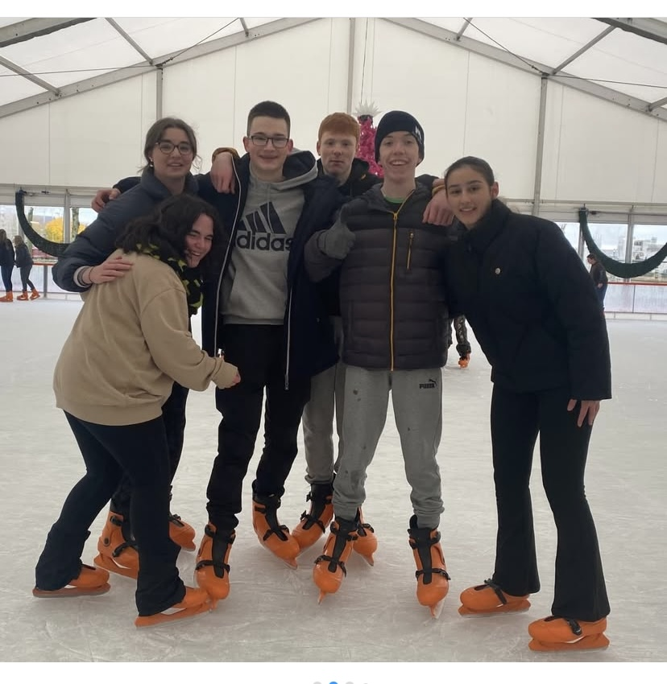

Slide 31
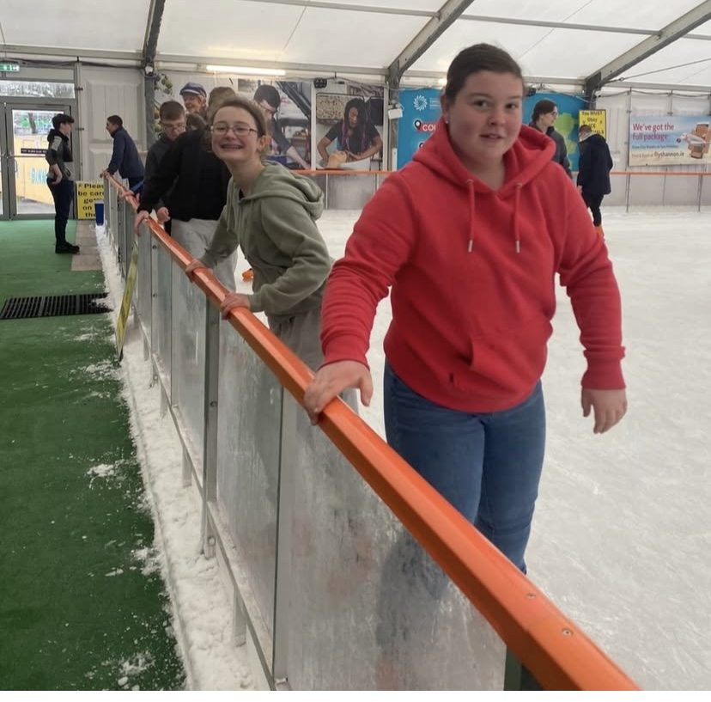

Slide 32
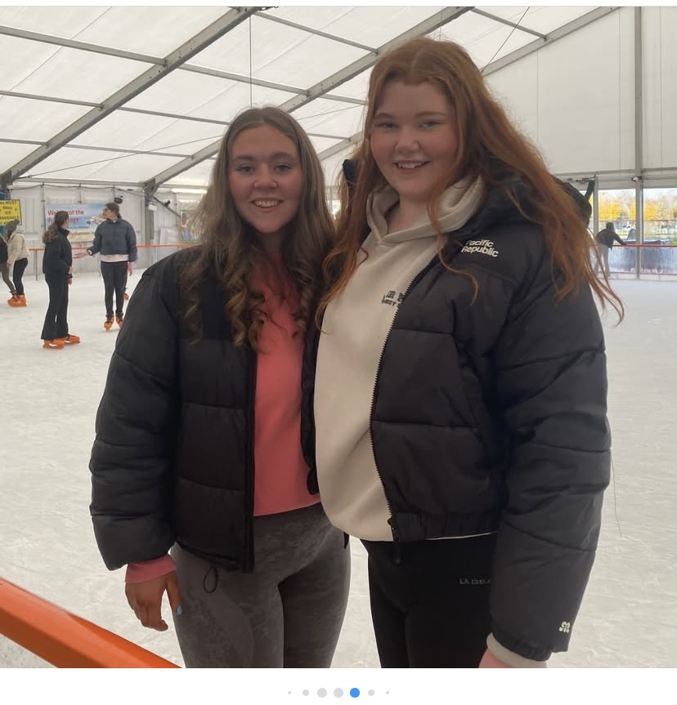

Slide 33
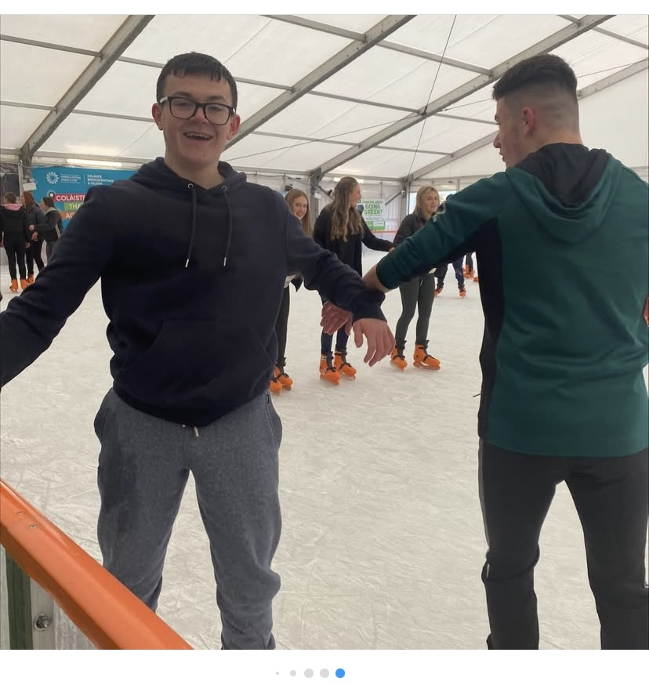

Slide 34
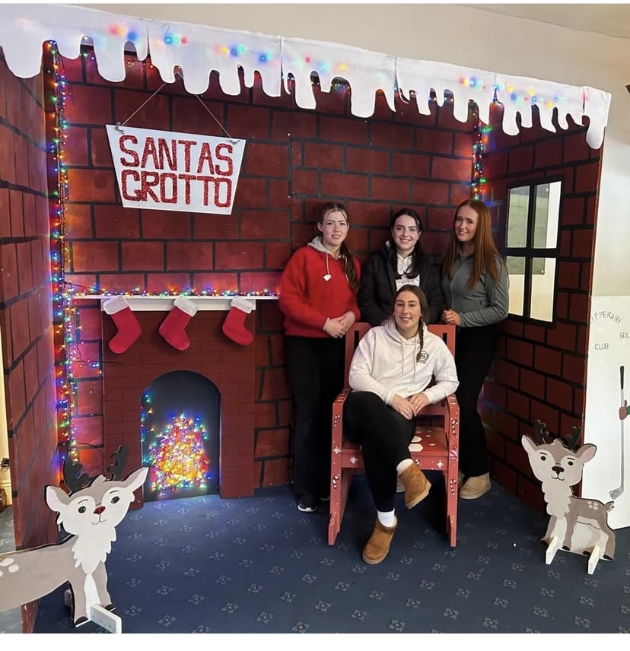

Slide 35
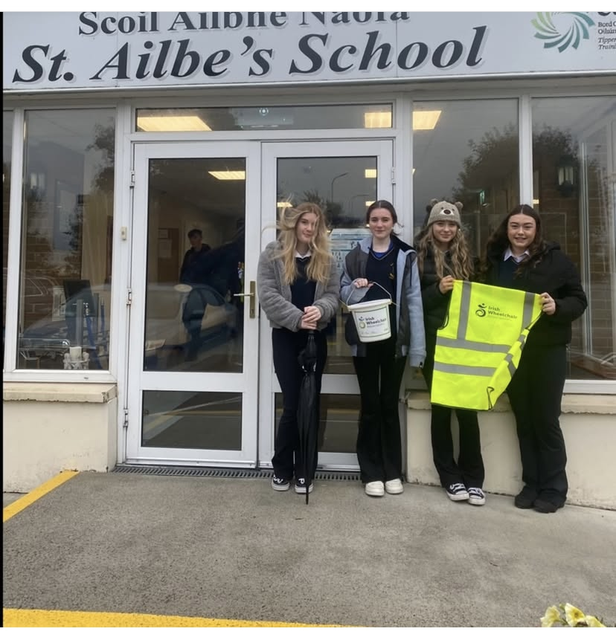

Slide 36
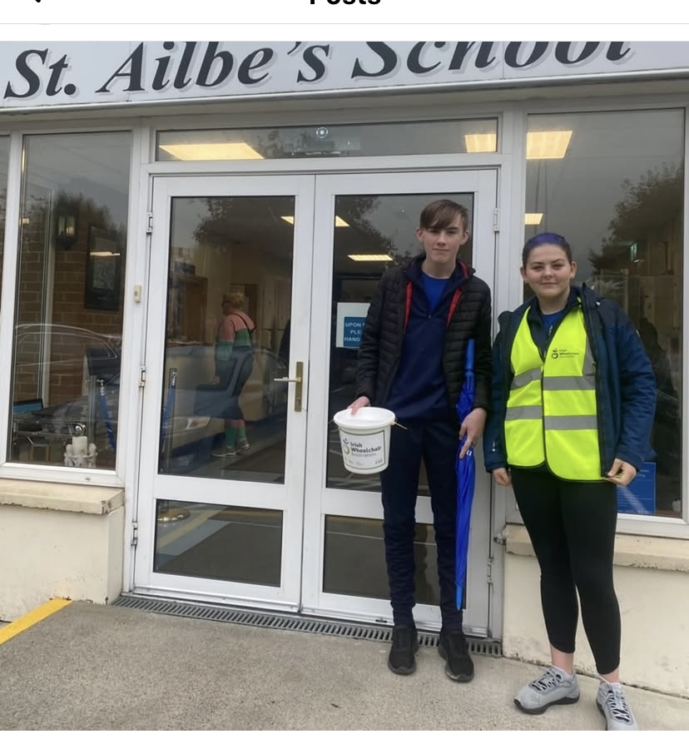

Slide 37
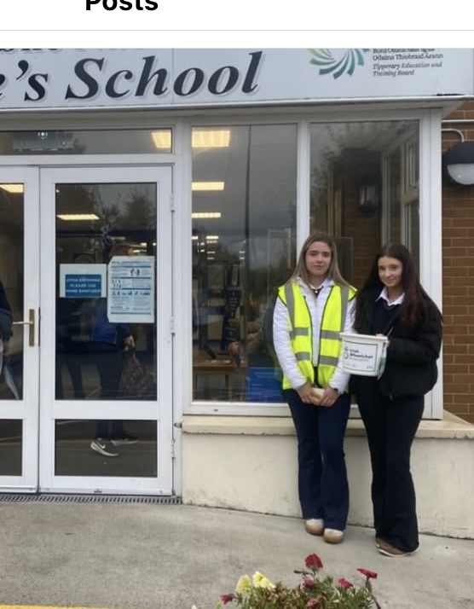

Slide 38
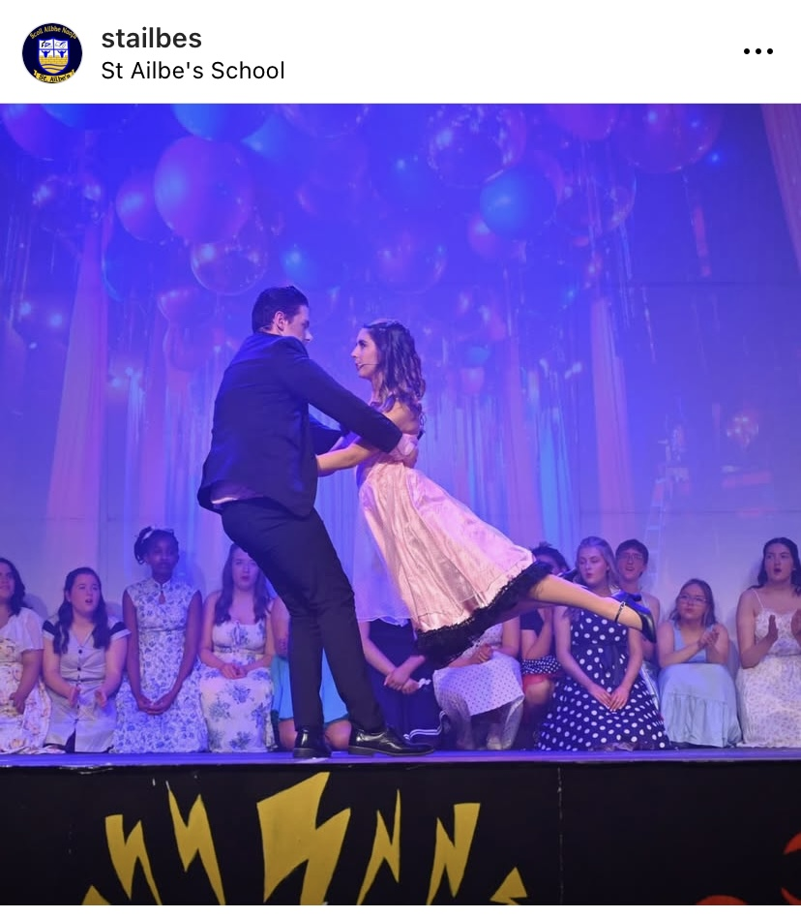

Slide 41
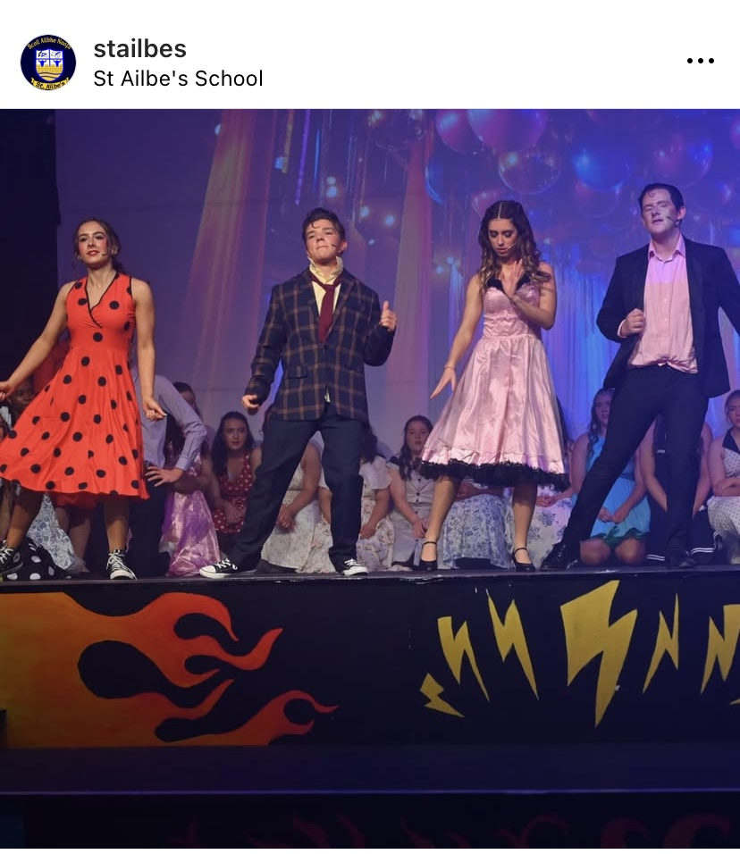

Slide 42
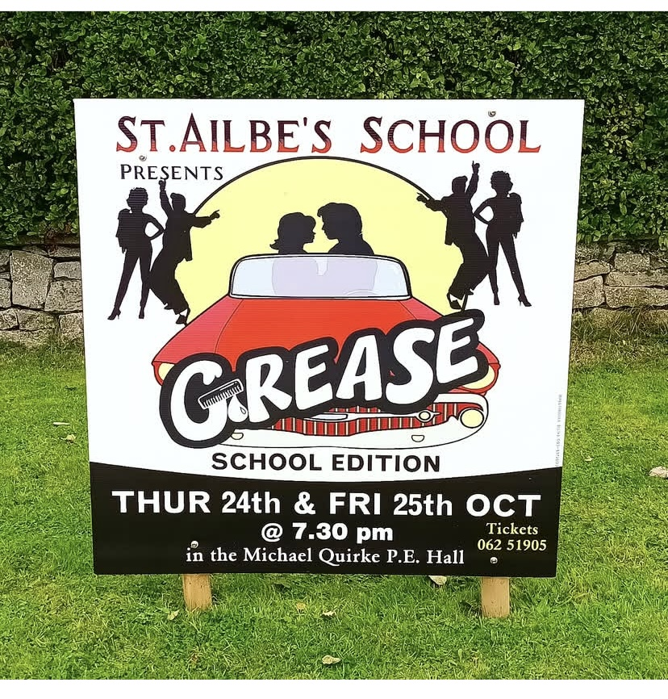

Slide 43
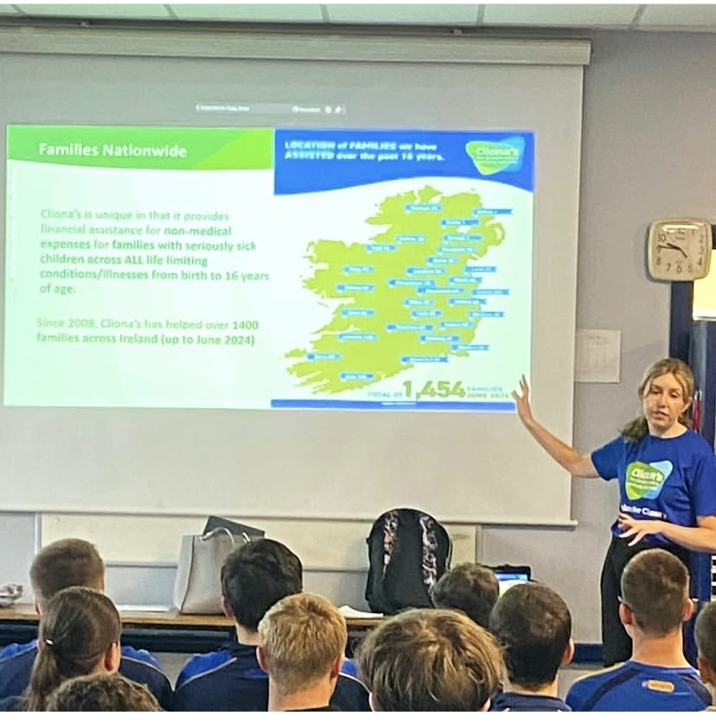

Slide 44
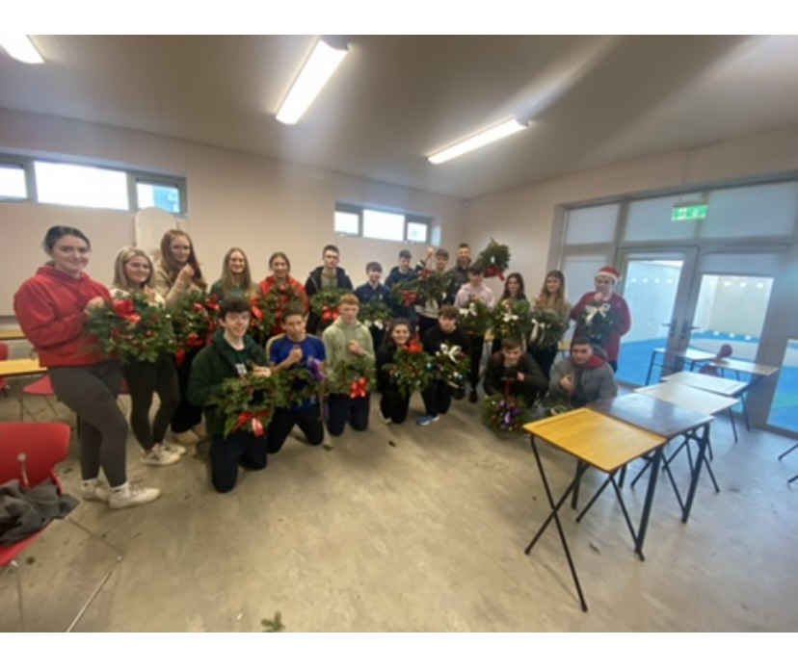

Slide 45
